Slide 1
Notes:
Intro:
COE, C&H 9’ Channel Mission, Team & Partners

Slide 2
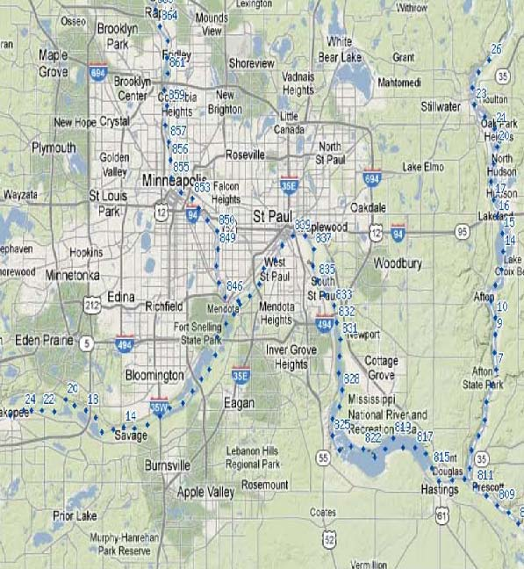

Slide 3
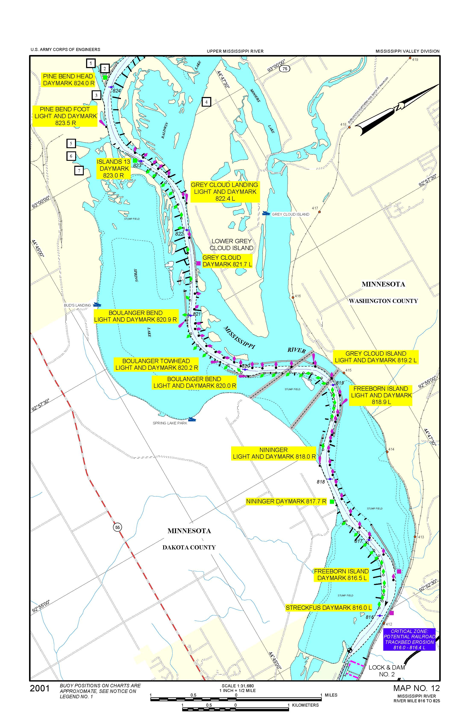
Notes:
Overview of Pool 2 (sub area of MVP)
Concern with Navigation, Safety, & Economics.

Slide 4
Pool 2 Channel Management Study
Freeborn Bend
  Channel is migrating downstream. West side of meander (between 819 and 820) is moving east and East Side is also shifting east. Wing Dams are being lost.
  Revetment below river mile 819 has significant loss. This is allowing for a lot of breakout flow out of the channel.

Slide 5
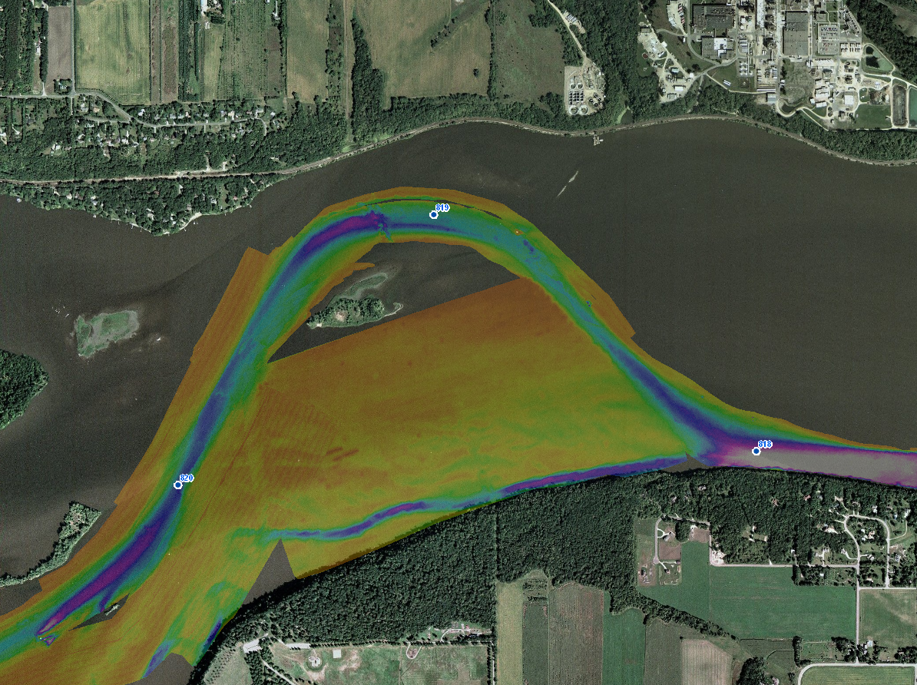
Pool 2 Channel Management Study
Current Condition
Notes:
Issues:
C&H
USCG ($750/buoy x 30 = $22,500 in buoys), $1000s in Daymarks & maint.
Nav Ind: Impacting navigation in/out of St. Paul, increasing costs to Nav Ind & local economy (study/economic evaluation to detail this more).

Slide 6
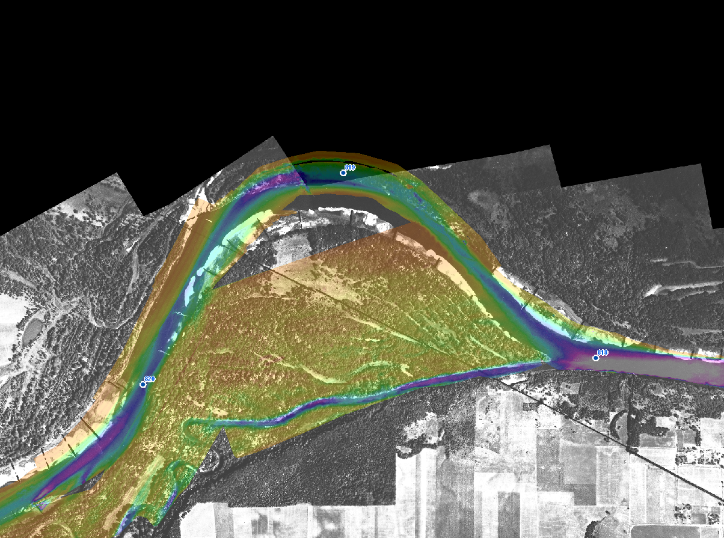
Pool 2 Channel Management Study
1927 Aerial with Current Condition overlay
Notes:
Issues:
C&H
USCG ($750/buoy x 30 = $22,500 in buoys), $1000s in Daymarks & maint.
Nav Ind: Impacting navigation in/out of St. Paul, increasing costs to Nav Ind & local economy (study/economic evaluation to detail this more).

Slide 7
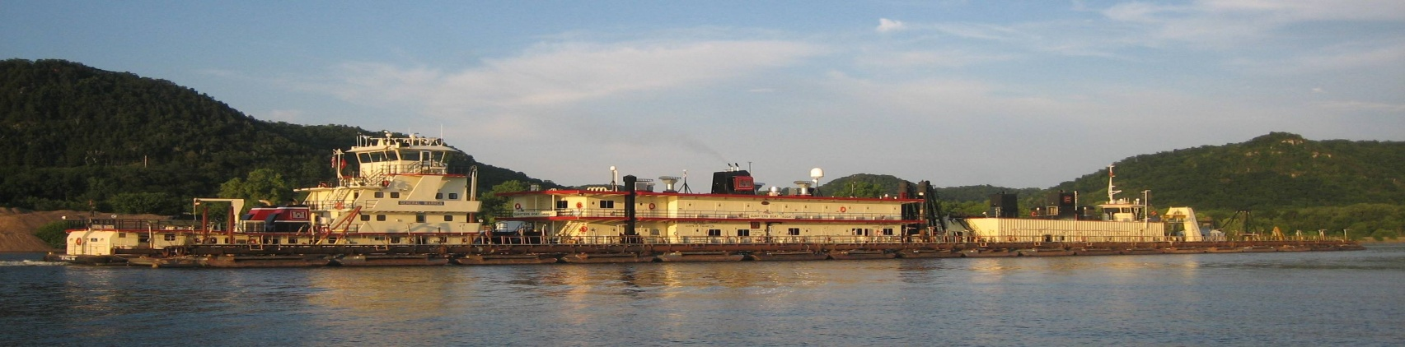
Pool 2 Channel Management Study
Issues/Concerns
  High frequency dredging location (COE) (~818 - 821)
    Historically 20 - 35% Frequency (once every 3 yrs)
    Since 2006 Freeborn & Boulanger has been annual or every other
      In last 6 years, have done 11 years worth of dredging
      Due to increase in flows
          Miss Rivers (~25) & Minnesota (~70%)
    More cost & placement sites filling faster (thus needing unloading)
      Finer material
    Pool 2 is only a 200’ wide authorized channel
      (vs. 150’ for SAF & 300’ Pools 3 - 10)
Notes:
Issues:
C&H
USCG ($750/buoy x 30 = $22,500 in buoys), $1000s in Daymarks & maint.
Nav Ind: Impacting navigation in/out of St. Paul, increasing costs to Nav Ind & local economy (study/economic evaluation to detail this more).

Slide 8
Pool 2 Channel Management Study
Issues/Concerns (con’t)
  Difficult & expensive to maintain AtoNs (USCG)
    ~30 Buoys & 4 Lights/Daymarks in 3 mile reach
    Needs constant attention (reposition, replace, rebuild)
Notes:
Issues:
C&H
USCG ($750/buoy x 30 = $22,500 in buoys), $1000s in Daymarks & maint.
Nav Ind: Impacting navigation in/out of St. Paul, increasing costs to Nav Ind & local economy (study/economic evaluation to detail this more).

Slide 9
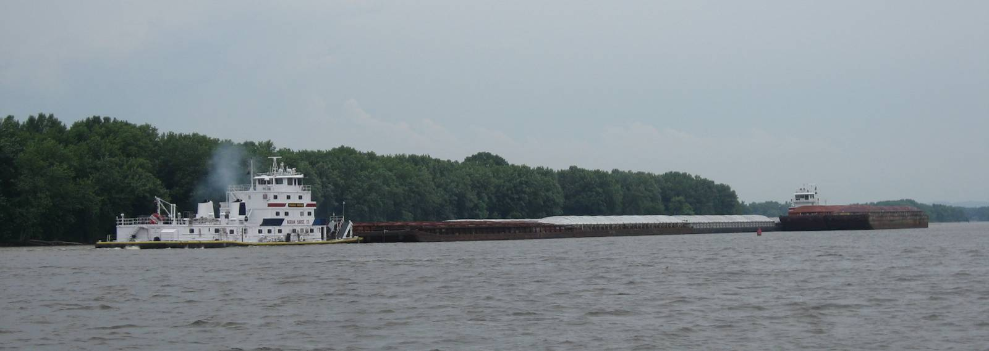
Pool 2 Channel Management Study
Issues/Concerns (con’t)
  Difficult to Navigate (Towing Industry)
    10 grounding reported 2011; 1 already in 2012; 45 since 1990
    River closures, smaller tow configurations & daytime running
Notes:
Issues:
C&H
USCG ($750/buoy x 30 = $22,500 in buoys), $1000s in Daymarks & maint.
Nav Ind: Impacting navigation in/out of St. Paul, increasing costs to Nav Ind & local economy (study/economic evaluation to detail this more).

Slide 10
Pool 2 Channel Management Study
Other Noted Issues/Concerns
  Gas Pipelines Under Channel
  Sewer Outfall Adjacent to Channel
  Spring Lake
    Alternatives to not increase flows/sedimentation in Spring Lake
  Recreational Boating Traffic
    Access to main channel from Mooers Lake & Grey Cloud Island
  Private Boat Docks
    Along/adjacent to existing main navigation channel
Notes:
Issues:
C&H
USCG ($750/buoy x 30 = $22,500 in buoys), $1000s in Daymarks & maint.
Nav Ind: Impacting navigation in/out of St. Paul, increasing costs to Nav Ind & local economy (study/economic evaluation to detail this more).

Slide 11
Notes:
Issues at Spring Lake, Moorers Lake, and Boat Docks.

Slide 12
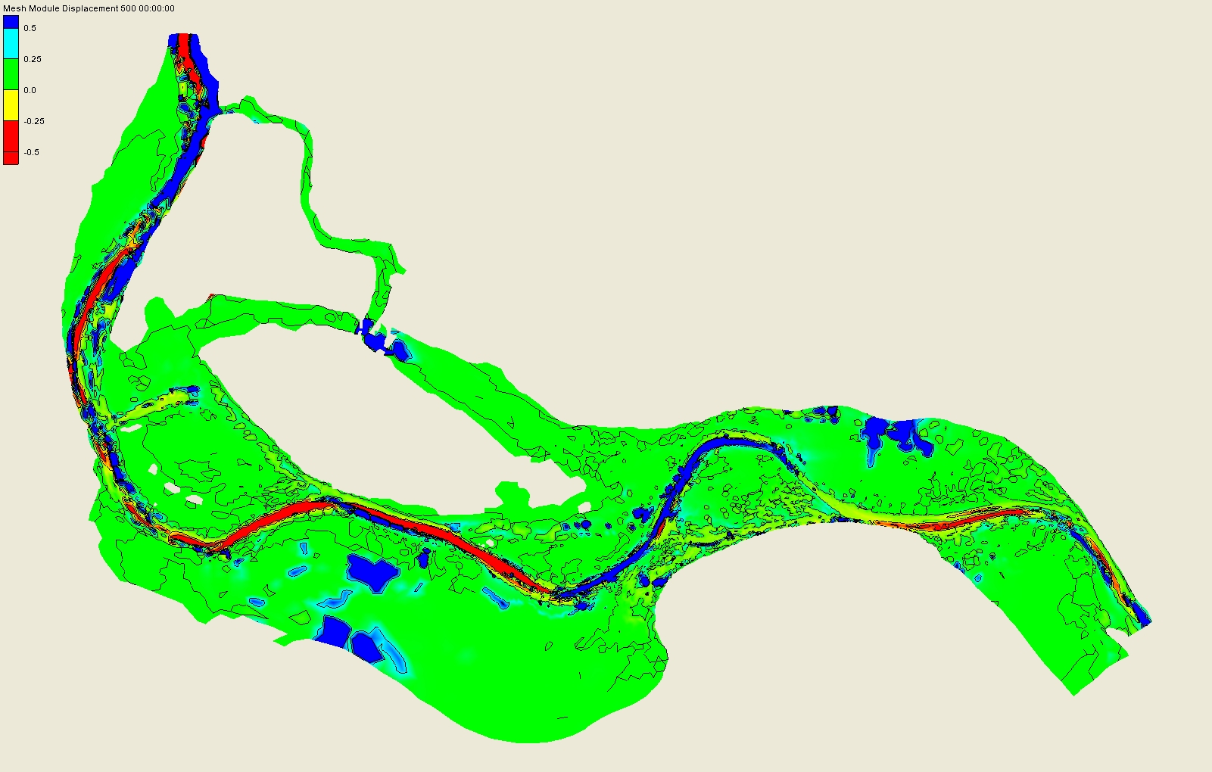
Existing - Conditions
Notes:
Showing today’s scour (red) and deposition (blue)

Slide 13
Pool 2 Channel Management Study
Alternatives Discussion
  No Action
    Maintain status quo
    Dredge to full authorized dimensions
  Channel Control Structures
    Revetment/linear island along channel
    Modify wing dams
    Rebuild historic Freeborn Island
  Realign the Navigation Channel
    Boulanger Slough
    Nininger Slough
  If Channel Realignment, material placement options?
    Upland placement on Grey Cloud Island
    Habitat Island upstream of LD#2
Notes:
Issues:
C&H
USCG ($750/buoy x 30 = $22,500 in buoys), $1000s in Daymarks & maint.
Nav Ind: Impacting navigation in/out of St. Paul, increasing costs to Nav Ind & local economy (study/economic evaluation to detail this more).

Slide 14
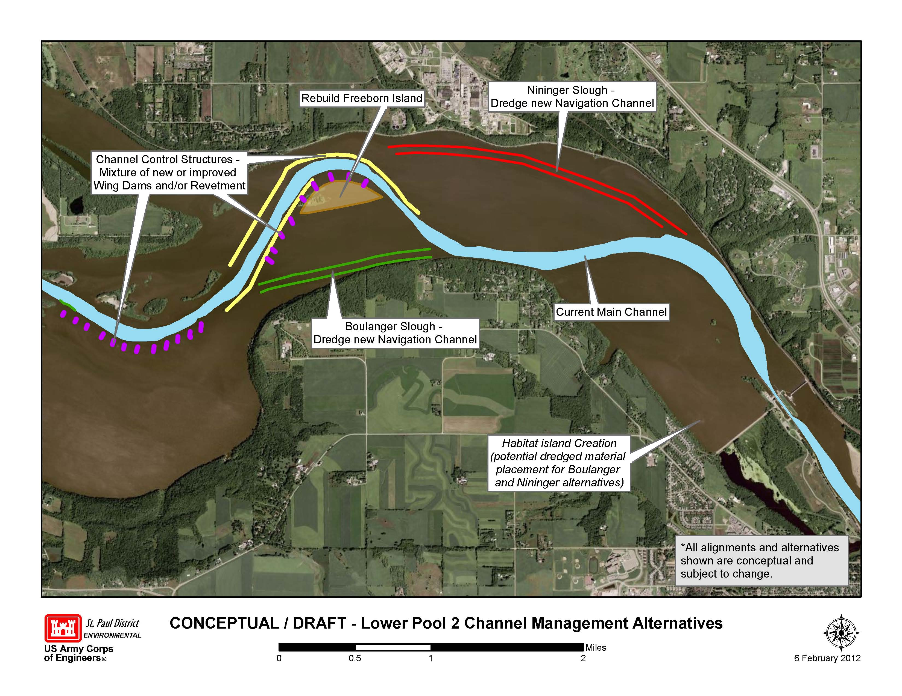


Slide 15
Geomorphic Reach 1 Bed Material Sources and Sinks
Sources of sediment include Bed Material Load at Anoka and Tributary Inflows
Sinks include Dredging and Backwater Deposition
Minnesota
River
St. Croix
River
Vermillion
River
Cannon
River
U/S
Mpls/StP
To GR 2 (Lake Pepin)
Minn River Dredging
Pool 2 Dredging
Pool 3 Dredging
Dredging u/s of Minn R
Pool 2 BW Deposition
Pool 3 BW Deposition
Upper Pool 4 Dredging
Upper Pool 4 BW Deposition
Sinks

Slide 16
Pool 2 Channel Management Study
Alternatives Discussion
  No Action
    Maintain status quo
      Dredge as resources dictate
          Equipment availability
            Pool 2 vs rest of MVP
          Placement site availability
            Make up of material
      Dredge to full authorized dimensions
          Equipment availability
            Pool 2 vs rest of MVP
          Placement site availability
            Additional Real Estate action
Notes:
Issues:
C&H
USCG ($750/buoy x 30 = $22,500 in buoys), $1000s in Daymarks & maint.
Nav Ind: Impacting navigation in/out of St. Paul, increasing costs to Nav Ind & local economy (study/economic evaluation to detail this more).

Slide 17
Pool 2 Channel Management Study
Alternatives Discussion
  Channel Control Structures
    Modify wing dams
Notes:
Issues:
C&H
USCG ($750/buoy x 30 = $22,500 in buoys), $1000s in Daymarks & maint.
Nav Ind: Impacting navigation in/out of St. Paul, increasing costs to Nav Ind & local economy (study/economic evaluation to detail this more).

Slide 18
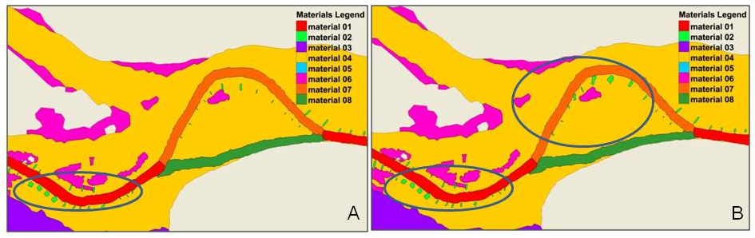
Wing Dam Modifications Alternative
Modify Wing Dams
  Attempt to make existing channel more efficient

Slide 19
Pool 2 Channel Management Study
Alternatives Discussion
  Channel Control Structures
    Revetment/linear island along channel
Notes:
Issues:
C&H
USCG ($750/buoy x 30 = $22,500 in buoys), $1000s in Daymarks & maint.
Nav Ind: Impacting navigation in/out of St. Paul, increasing costs to Nav Ind & local economy (study/economic evaluation to detail this more).

Slide 20
Pool 2 Channel Management Study
Islands/Rock Mound elevation = 688.0 (+ 1.4’ LCP).
Effects
  More flow in main channel until dam goes ‘out of control’.
  More Flow in Nininger Slough
  Higher velocities Spring Lake Outlet. Uncertain if Inflow to Spring Lake is higher.
  100yr (150,000cfs) stage increase of about 0.025 at Spring Lake and 0.013 at Upper end of Model.
  0.007 ft at St. Paul.

Slide 21
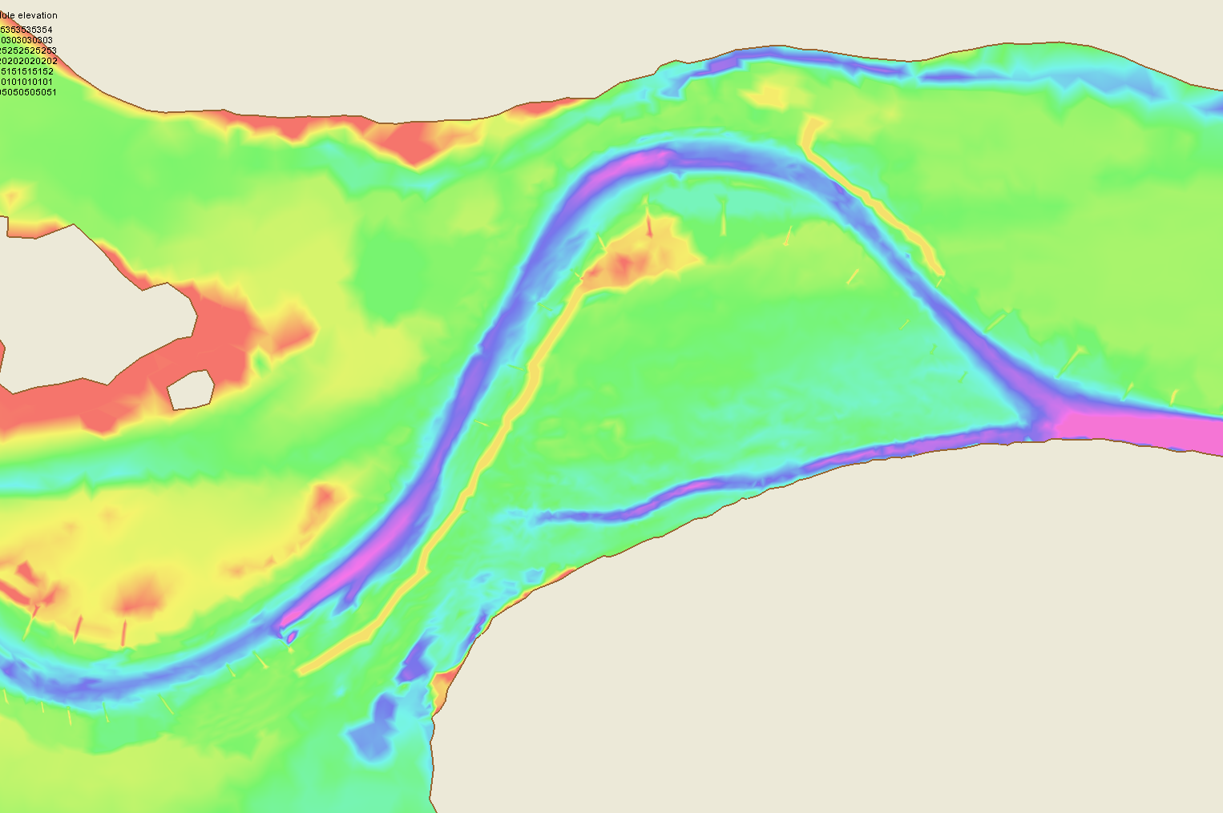
Islands/Rock Mound Locations

Slide 22
Pool 2 Channel Management Study
Alternatives Discussion
  Channel Control Structures
    Rebuild historic Freeborn Island
Notes:
Issues:
C&H
USCG ($750/buoy x 30 = $22,500 in buoys), $1000s in Daymarks & maint.
Nav Ind: Impacting navigation in/out of St. Paul, increasing costs to Nav Ind & local economy (study/economic evaluation to detail this more).

Slide 24
Pool 2 Channel Management Study
Boulanger Slough
  Eliminate near 90-degree bend in river.
    River Mile 818 to 820.
Notes:
Before we align we need to ID issues - pipeline.

Slide 25
Approximate Channel
Realignment Location

Slide 26
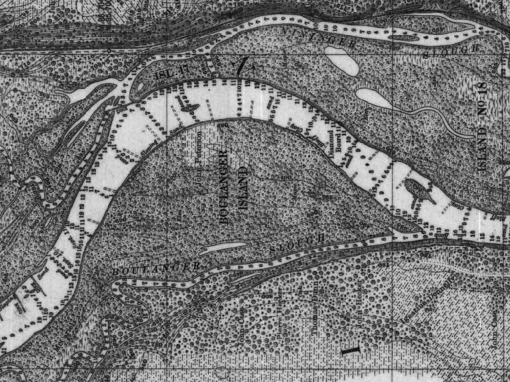
Notes:
Pre-inundation survey (later 1800’s early 1900’s)

Slide 27
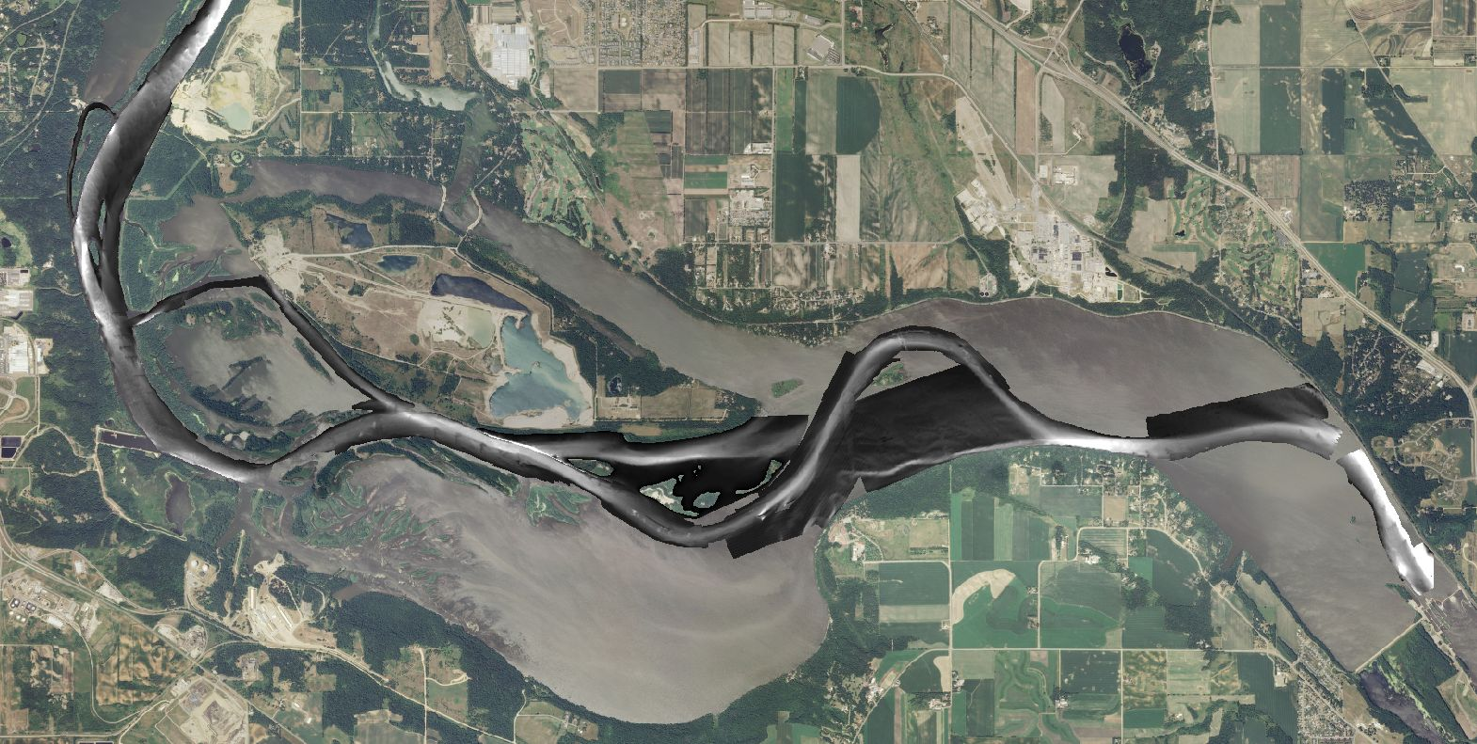

Slide 28
Pool 2 Channel Realignment Study
Boulanger Slough
  Eliminate near 90-degree bend in navigation.
    River Mile 818 to 820.
  Issues
    Northern Natural Gas Pipelines
Notes:
Before we align we need to ID issues - pipeline.

Slide 29
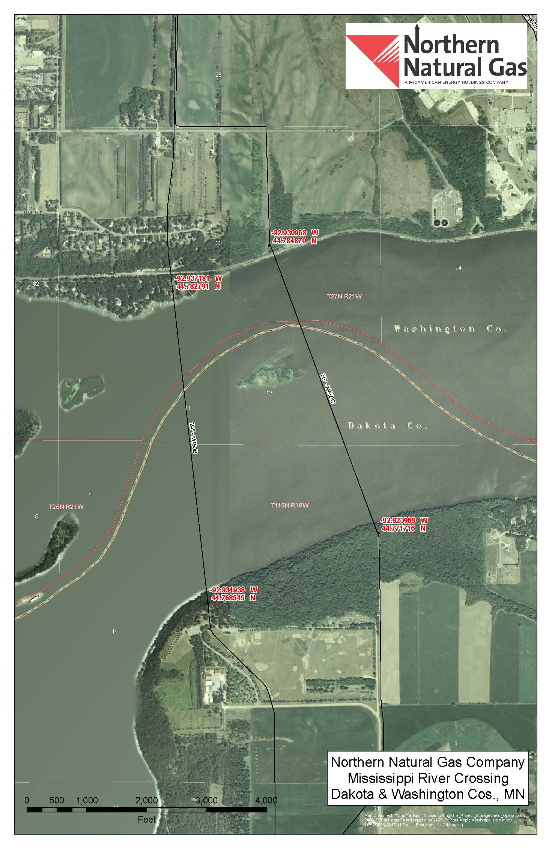

Slide 30
Pool 2 Channel Realignment Study
  Northern Natural Gas Pipe Lines
    Dredge to 12’ below LCP
    Pipelines ~21 - 22’ below LCP
    ~10’ clearance

Slide 31
Pool 2 Channel Realignment Study
Realignment @ Boulanger Slough
  Hydraulics
      Use of Boulanger Slough as main navigation channel
  Wing dams rebuilt
  Notched closure across existing channel

Slide 32
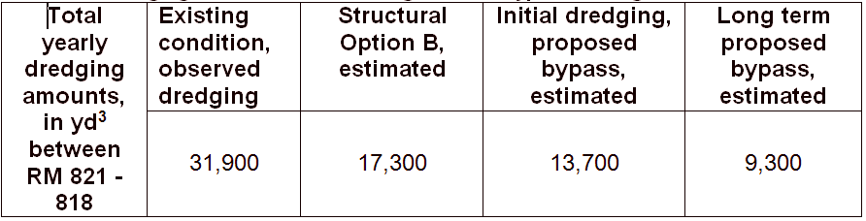
Expected long-term conditions with the Boulanger Slough channel realignment.
Pool 2 Channel Realignment Study

Slide 33
Pool 2 Channel Realignment Study
Realignment @ Boulanger Slough
  Hydraulic Model Results
    Need to dredge ~450,000cy of material (330’W x 6600’L)
    Channel control structure alternatives
        Add closure to block off existing channel
        Add/modify wing dams

Slide 34
Pool 2 Channel Realignment Study
Nininger Slough
  Eliminate near 90-degree bend in navigation channel.
    River Mile 818 to 820.
  Issues
    MET Council outfall
Notes:
Before we align we need to ID issues - pipeline.

Slide 35
Approximate Channel
Realignment Location

Slide 36
Notes:
Pre-inundation survey (later 1800’s early 1900’s)

Slide 37
Pool 2 Channel Realignment Study
Nininger Slough
  Need Further Hydraulic Analysis
  Rough length & width (330’x10,500’)
    ~1,000,000cy
  Contaminants in material

Slide 38
Pool 2 Channel Realignment Study
What we know so far:
  No Action has options
  Channel Control Structure Mods/additions promising
    Wing Dam modifications
    Linear island/revetment
    Freeborn Island
  Boulanger Slough Channel is Feasible
    After ~10 years dredging decrease to 1/3 of current
    New channel better option than current practices
    Less USCG AToNs Maintenance
    Safer Navigation Channel
  Nininger Slough needs further investigation

Slide 39
Pool 2 Channel Realignment Study
Project Impacts
  Least Costly, Environmentally Acceptable alternative
  National Environmental Policy Act (NEPA) compliance
    Evaluate impacts on:
      Water Quality, Sediment, Fish & Wildlife, Cultural, Social…etc.
      Additional sediment testing needed.
  What to do with ~450,000 - 1,000,000 cy material
      Strong support for Island Building in Lower Pool 2
        Work with Partners on options
          Agency Partners
          Private Industry Partnerships

Slide 40
Pool 2 Channel Realignment Study
Next Steps
  Complete DRAFT Report
    Design/Evaluate/Economics Alternatives
    NEPA Documentation of Alternatives
    ID Preferred Alternative
      ~June 2012
    Public Meeting on Preferred Alternative
      ~July 2012
  Finalize Report
    ~November 2012
    River Resources Forum Endorsement (Dec 2012)

Slide 41
Pool 2 Channel Realignment Study
Next Steps (con’t)
  Funding
    C&H Submitted request for construction funding for FY13 (~$5M).
      Still being developed
    Favorable FY13 Presidents budget
      If sufficient benefits
      Project is within authority and projected funding.
  Construction
    ~Award contract Summer 2013.

