Slide 1
Fox River Cleanup Overview 2012

Slide 2
Project Participants
Responsible Parties (RPs)
NCR – Arjo Wiggins / Appleton Papers Inc.
PH Glatfelter – US Mills / Sonoco Corp.
WTM1 - CBC Coatings / Riverside Paper
Georgia Pacific
Contractor: Tetra Tech
Dredging: J. F. Brennan
Processing: Boskalis – Dolman / SPRI
QA: Foth Environmental, PACE Labs
Agency Oversight (EPA / WDNR)
The Boldt Company, NRT, Aether, Kern Statistical, Palermo, Hill

Slide 3
Current Project Status
OU1
RA completed in 2009
Dredged 372,500 yards, capped 112 acres, covered 103 acres
addressed 5% of total river PCB mass (2,500 lbs)(73% removed)
Fish tissue tests resulted in reduction of consumption advisories
Successful habitat restoration of processing site completed

Slide 4
Current Project Status
OU3
All remedial action completed, 2009 - 2011
Dredged 225,000 yards, capped 27 acres, covered 114 acres
addressed 5% of total river PCB mass

Slide 5
OU4 – Current Project Status
OU4
Started RA in 2009, 1.3 million yds removed to date
Dredging terminated in June 2011 (160,000 yds removed vs 525,000 planned)
2012 RAWP developed by RP’s, modified by Agencies (660,000 yds)
RP’s in disagreement on path forward
RA work has not yet started this year, PI in Federal Court
RA Work is performed under a UAO, not a Consent Decree

Slide 6
Tour Overview
Processing Plant Site Tour
Bus to project site – 1 mile away
Tour groups of 10 - 15
All participants to sign LLC Waiver
Safety PPE will be provided at the site
Buses will return to Lambeau Field

Slide 7
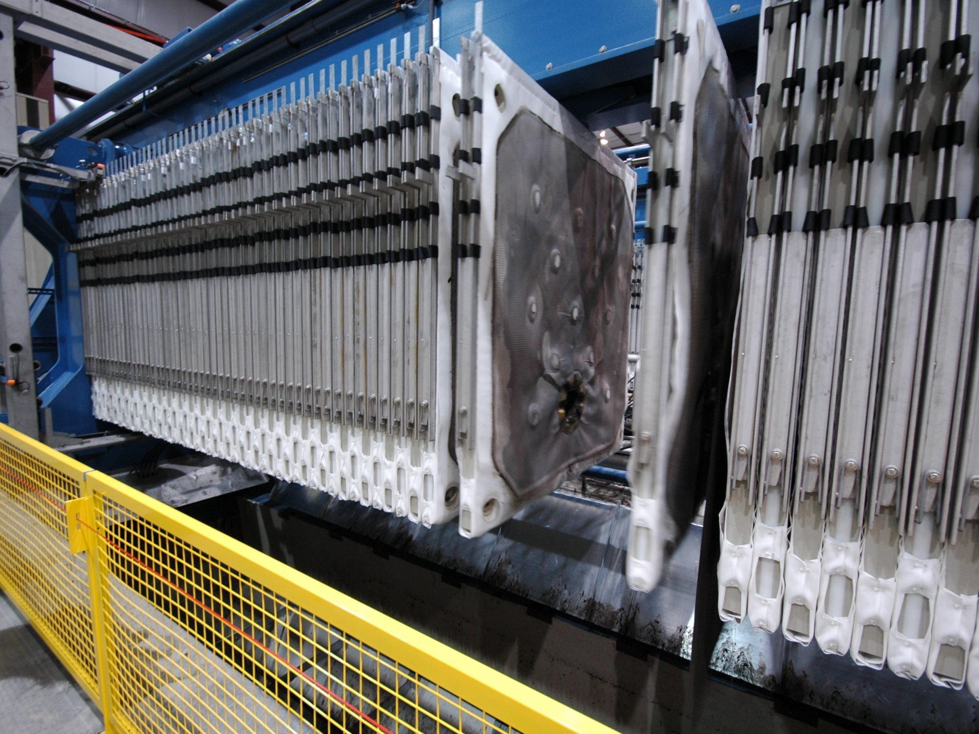
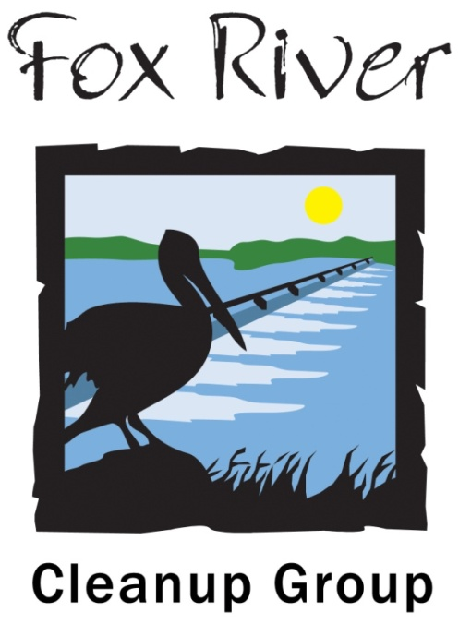
The Fox River Cleanup Project
Notes:
Introduction of team
Scott Stein – Leonard & Finco Public Relations
Susan Finco – Leonard & Finco Public Relations
Hired by the project to provide community outreach
Tetra Tech is the prime contractor for the project
Bill Coleman – Project Manager
Rich Feeney – Project Engineer
George Willant – Deputy Project Manager
We’d be happy to take your questions about the project at the end.

Slide 8
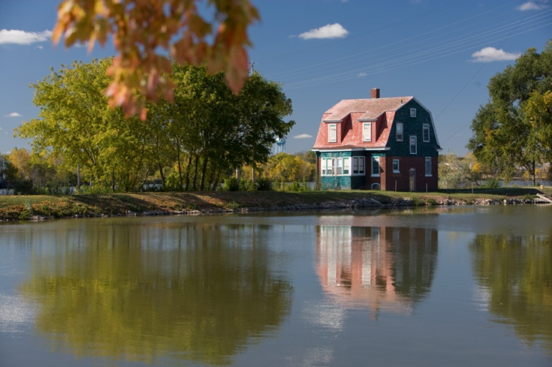
Project Overview
The Fox River Cleanup Project is designed to reduce the risk to human health and the environment due to the presence of polychlorinated biphenyls (PCBs) in the Lower Fox River

Slide 9
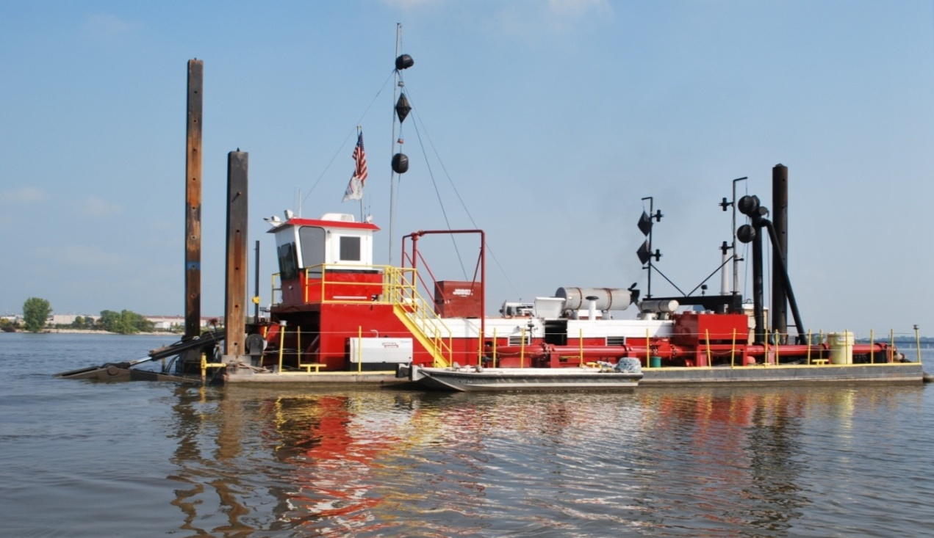
Project Overview
The project involves a combination of dredging, capping and covering over a 13-mile stretch of the river

Slide 10
Project Overview

Slide 11
Project Overview
Tetra Tech is the prime contractor
Subcontractors –
J.F. Brennan
Boskalis-Dolman/Stuyvesant Projects Realization
Gene Frederickson Trucking

Slide 12
The First Three Years
All work completed in OU3 – the area south of the De Pere Bridge
More than 1.5 million cubic yards of sediment dredged and processed
Nearly 820,000 tons of processed sediment hauled to the landfill

Slide 13
The First Three Years
More than 34,500 truckloads to the Hickory Meadows Landfill in Calumet County
Approximately 170 acres of river bottom capped or covered
1.9 billion gallons of water removed, treated and returned to the river
Nearly 120,000 tons of sand produced for beneficial reuse

Slide 14
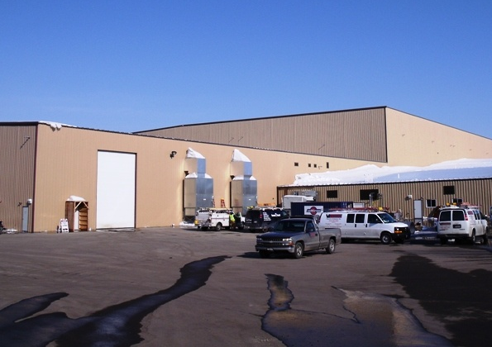
Green Bay Processing Facility
1611 State St., Green Bay
250,000 square feet
Operates 24/5
Notes:
Processing facility located at 1611 State Street – just north of GP

Slide 15
Green Bay Processing Facility
Sediment processing equipment, including eight of the world’s largest membrane filter presses
Water treatment
Filter cake storage and truck loading area
Offices
Staging area for capping and covering operations downstream from the De Pere Dam
Notes:
About 100 workers on the project during the operational season
During construction, as many as 350 workers on site

Slide 16
Dredging
Notes:
Not like the scoop and bucket typically used to dredge the shipping channel
The dredges are guided by GPS systems
Turbidity monitors at each end of the dredges

Slide 17
Transportation
Trucks transport the processed sediment to the Hickory Meadows Landfill in Calumet County weekdays
All trucking must comply with local, state and federal rules and regulations
Trucking operations are monitored by project personnel
Notes:
Gene Frederickson Trucking – Kaukauna
Tetra Tech Health & Safety Team uses its own radar gun to monitor the trucks

Slide 18
Transportation
The primary route is:
Ashland Ave. (Hwy. 32) to Hwy. 172
Hwy. 172 to Hwy. 57
Hwy. 57 to Schneider Road
Schneider Road to the landfill
The secondary route is:
Ashland Ave. (Hwy. 32) to Hwy. 41
Hwy. 41to County U
County U to Hwy. 96
Hwy. 96 to Hwy. 57
Hwy. 57 to Schneider Road
Schneider Road to the landfill
There are about 100-120 truckloads to the landfill each day
Notes:
With various highway projects in the area over the course of this project, it’s certainly possible that the truck route will have to be revised at tome point.

Slide 19
De Pere / Rockland Staging Area
Between Hwy 57 and the Fox River near the De Pere – Rockland border
Was used first three years to stage capping and covering materials and equipment
Was not used for any sediment processing or sediment storage

Slide 20
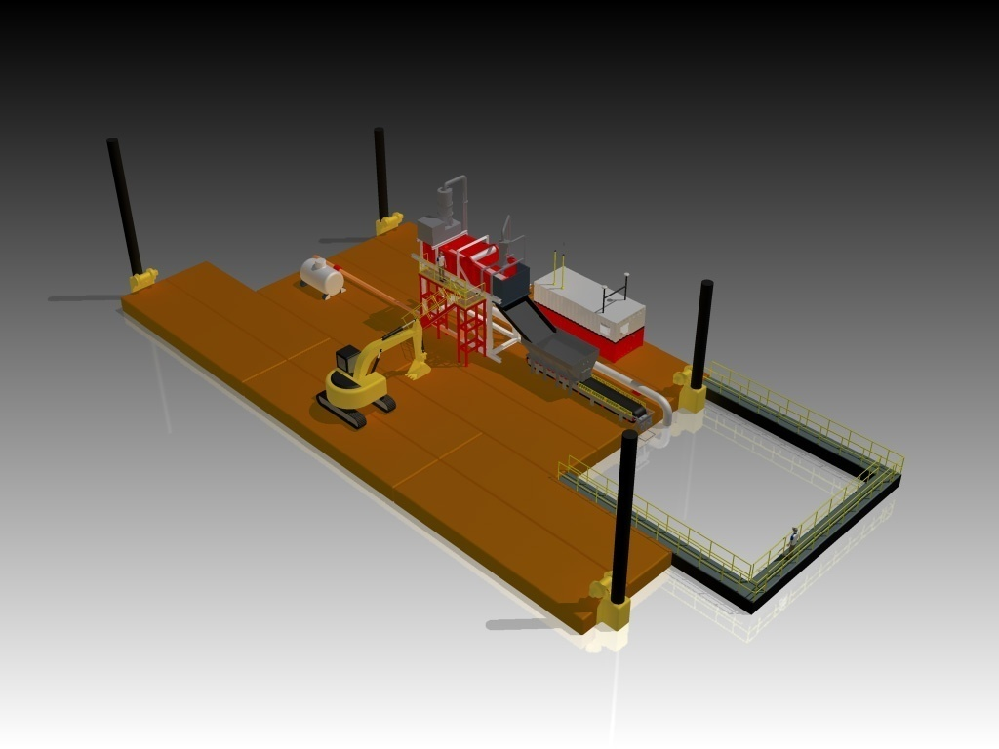
Capping / Sand Covering
Notes:
Caps / covers range from 6-8” sand cover to a 33” cap that includes sand, gravel and quarry stone.

Slide 21
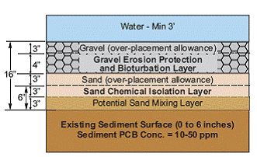
Capping / Sand Covering
Notes:
Caps / covers range from 6-8” sand cover to a 33” cap that includes sand, gravel and quarry stone.

Slide 22
Oversight
U.S. Environmental Protection Agency
Wisconsin Department of Natural Resources
Agency Oversight Team (A/OT) has on-site office
Long Term Monitoring Plan
Notes:
The 919,200+ work hours without a lost time incident does not include the transportation hours

Slide 23
Health & Safety
Safety is a top priority
Formal health and safety plans are in place
On the river, at the processing facility, at the staging area, on the road
Numerous monitoring programs in place
The project has reached 965,000 work hours without a lost time incident
Notes:
The 919,200+ work hours without a lost time incident does not include the transportation hours

Slide 24
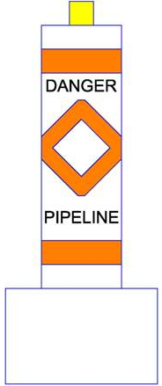
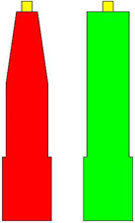
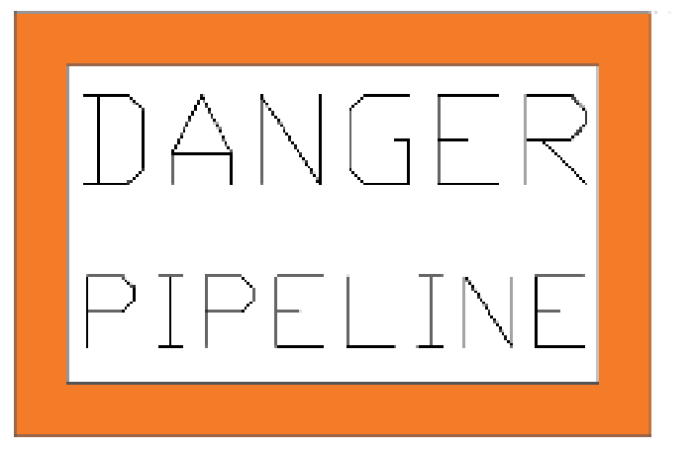
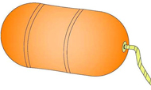
Health & Safety
Large rectangular signs mark the pipeline.
DO NOT CROSS!
Lighted orange & white buoys alert watercraft to the pipeline area.
STAY CLEAR!
Orange pipe delineators mark where the pipeline is submerged.
PROCEED WITH CAUTION!
Lighted green and red buoys mark channels for safe crossing.
CROSS BETWEEN GREEN & RED BUOYS!
Notes:
Safety is a top priority in the processing facility, for the transportation and all of the work on the river.
Rack cards distributed to boating, fishing outlets – handed out at boat launches – signs at boat launches – mailed to all residents with boats registered in Brown County – annual media event to highlight safety on the river.

Slide 25
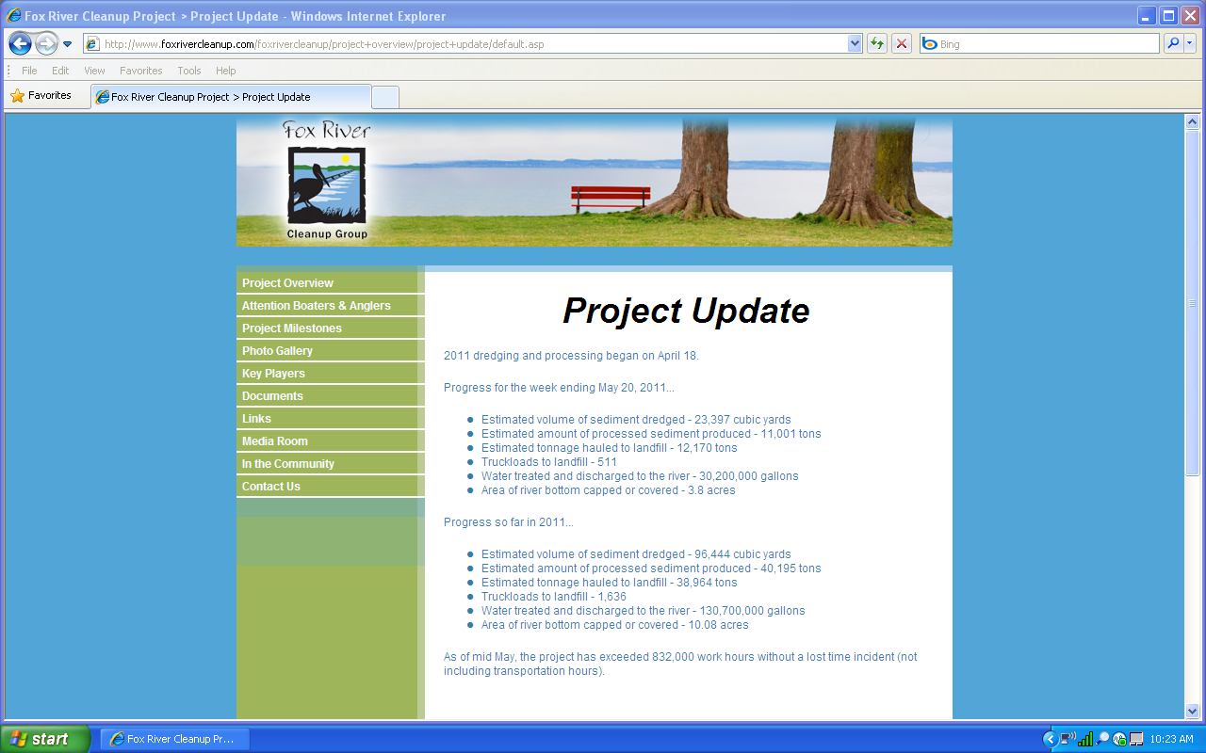
Fox River Cleanup Project
To learn more, go to: www.foxrivercleanup.com
Contact the Fox River Cleanup Group at:
877-FOX-RIVR (877-369-7487)
or info@foxrivercleanup.com

Slide 27
Questions?
Notes:
What have you found while dredging?
How long will the project continue? Are you on schedule?

