Slide 1
Extreme Weather Pumping & Dewatering
WEDA Midwest Chapter Spring 2012 Meeting
April 26, 2012
Presented by Scott Ponstein

Slide 2
Project Overview
Preferred Sands silica sand mine
Woodbury, MN
January 2012
Sand silica waste, by-product of silica sand washing process
Pump sand waste from frozen settling pond
Dewater in geotextile tubes

Slide 3
Preferred Sands

Slide 4
Scope of Work
Very short time frame (3 days from approval to mobilization)
Remove 2 million gallons of material from frozen settling pond
Utilize Pit Hog pumps to move material
Geotextile tubes to dewater

Slide 5
Equipment
Chain saw
Gantry crane & truck-mounted boom crane
(2) Pit Hog pumps with hydraulic power packs
(2) 6” diameter HDPE pipelines
22 gph polymer makedown & injection system
(2) Geotextile tubes, 75’ by 200’
10,000 lb off road forklift
Miscellaneous torches and heaters.

Slide 6
Method
Holes cut in ice using chain saw
Pumps, suspended by cranes, lowered down into pond
Pumped sand slurry injected with polymer
Sand slurry-polymer mixture pumped into geotextile tube for dewatering
Geotextile tube weep water pumped back to pond

Slide 7
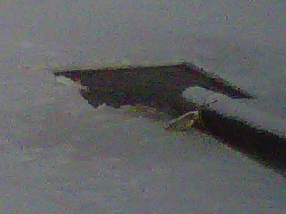
Site Photos
Hole cut in ice

Slide 8
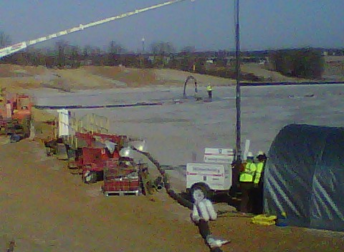
Site Photos
Pump suspended with crane truck

Slide 9
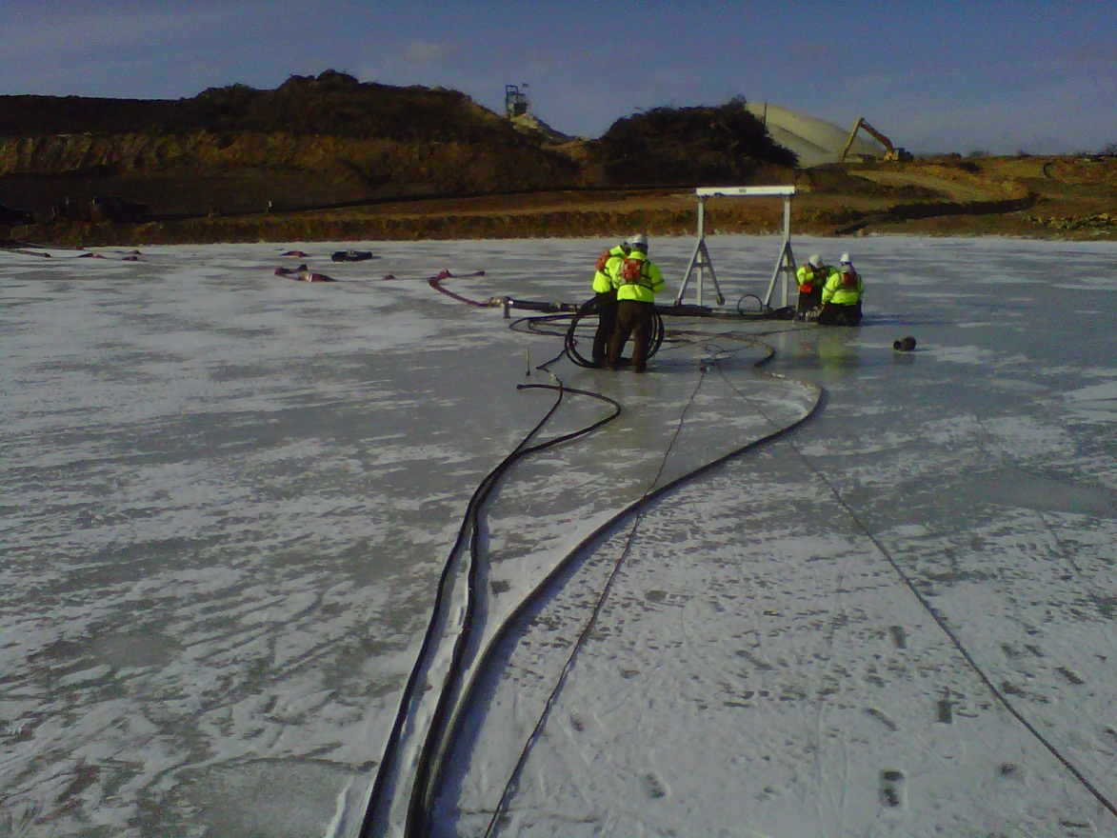
Site Photos
Pumping operation

Slide 10
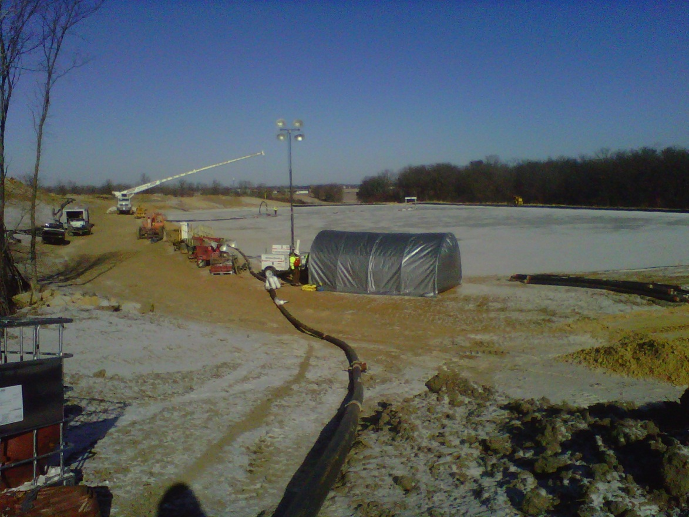
Site Photos
Polymer system hut with crane truck & pond in background

Slide 11
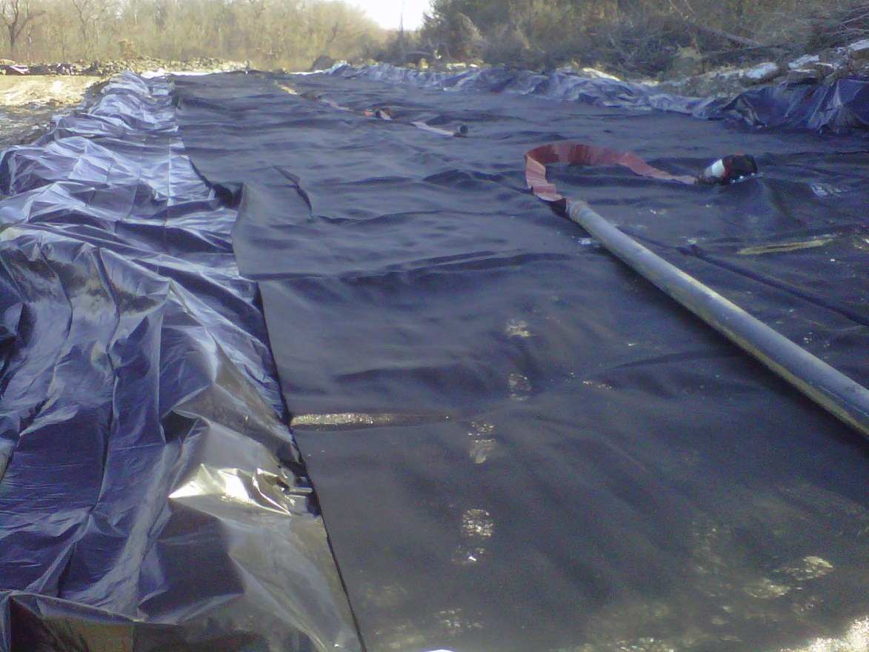
Site Photos
Geotextile tube prior to filling

Slide 12
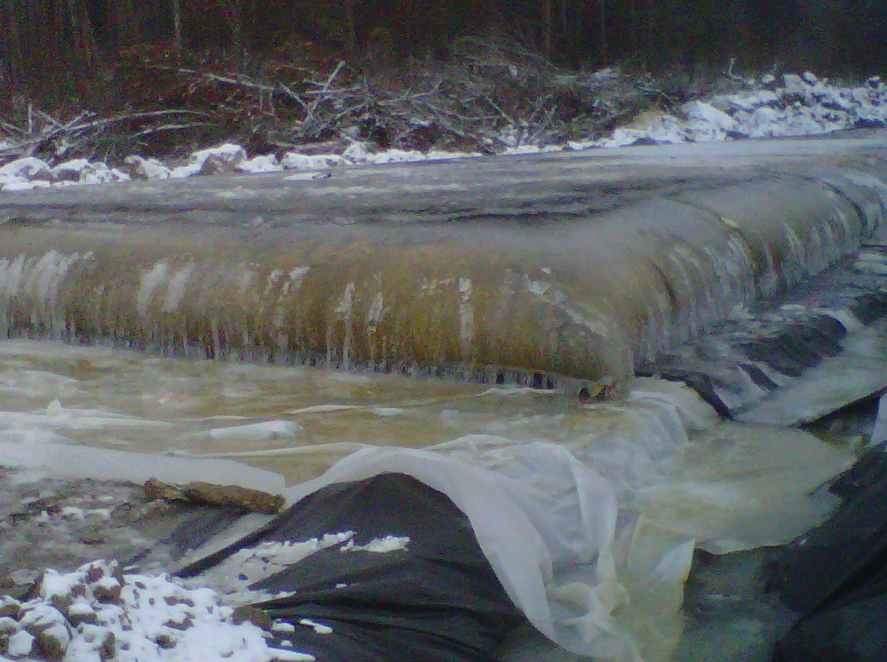
Site Photos
Geotextile tube during pumping

Slide 13
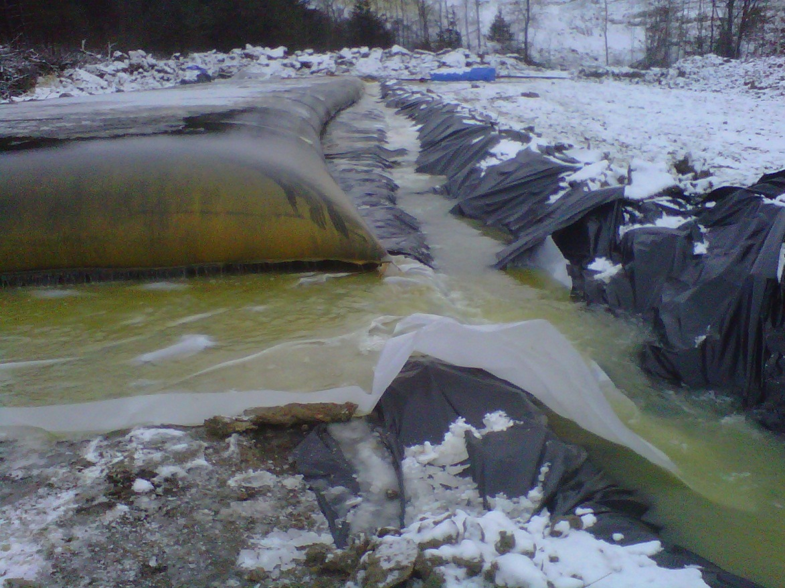
Site Photos
Weep water drainage

Slide 14
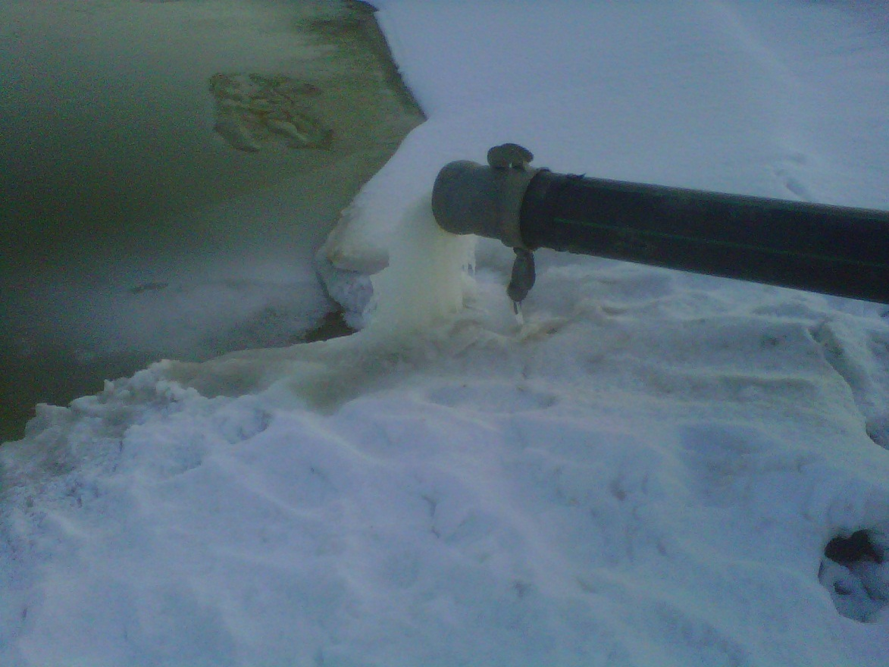
Site Photos
Weep water return pipeline

Slide 15
Challenges
Below zero temps nearly every day
Working on ice (slips/falls, breaking through)
Keeping ice from forming around the pumps
Polymer system freezing up
Pipelines freezing during shutdowns
Geotextile tube freezing overnight

Slide 16
Complications of the Cold
Actual polymer dose was up to 4 times what was expected
Had to disassemble pipelines and completely drain them every night to prevent freezing
Stress on mechanical equipment (pumps)
Geotextile tubes performed differently
3-4” ice formed on geotextile tubes overnight; hard to dewater in the morning

Slide 17
Summary
Level of the pond lowered 3 ft
Depth of sand waste lowered 5 ft
Project completed in 14 days (including mobilization & demobilization)
Satisfied client

Slide 18
Questions about the project?

Slide 19
Contact Information
Scott Ponstein, Field Engineer
sponstein@infralt.com
Infrastructure Alternatives
7888 Childsdale Ave NE
Rockford, MI 49341
616-866-1600
www.InfrastructureAlternatives.com

