Slide 1


Survey of University Dredging-
Related Education
Gregory L. Williams, Ph.D., P.E
and
Isabella Aftanis
UNCW
Donald F. Hayes, Ph.D., P.E., BCEE, F.ASCE
The Dredging Professor
Eastern Chapter Conference - Baltimore Maryland October 15-17, 2024

Slide 2

Introduction
Motivation
Survey
ASBPA Coastal Universities Guide
Survey responses
Additional input/comments
QR Code for YOUR input/comments

Slide 3
Agenda
Survey Scope
Survey Response
Summary of Programs with Dredging Courses/Modules
Questions/Recommendations

Slide 4
Survey
Do you currently offer a dredging-specific class (undergraduate or graduate), i.e., the class has the word “dredging” in the class name and/or at least 50% of the class is focused on dredging?
  If yes, will you provide a POC and/or syllabus for follow-up discussion?
  If no, do you plan to offer such a class in the future?
If the answer to #1 above is “no,” do you offer a class (undergraduate or graduate) that has a module or lecture focused on dredging?
  If yes, will you provide a POC and/or syllabus for follow-up discussion?
  If no, do you plan to add this to an existing class in the future?

Slide 5
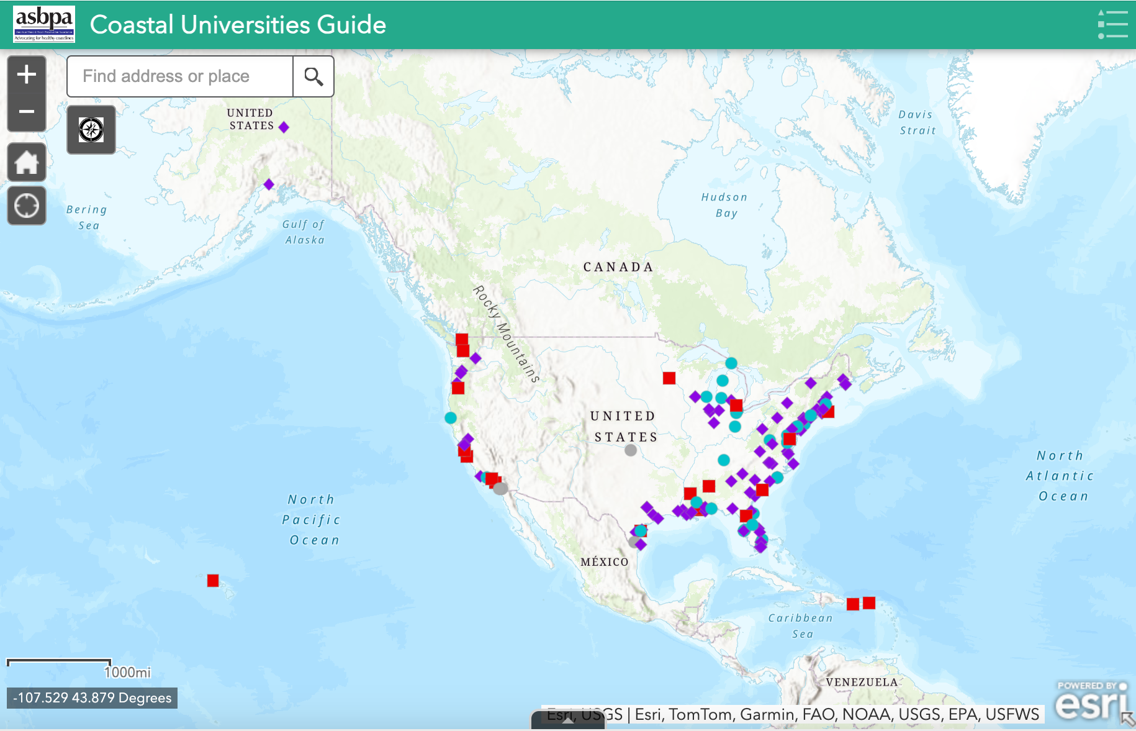
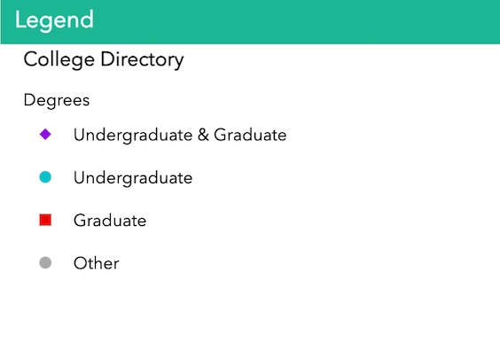
ASBPA Coastal Universities Guide
Notes:
Add legend to this slide

Slide 6
Total Survey Responses

Slide 7
Survey Responses

Slide 8
“Yes” Responses
Yellow Dots:
UNCW
University of Florida
University of South Alabama
University of New Orleans
Red Dots:
Old Dominion University
Texas A&M
Stevens Institute of Technology
Florida Institute of Technology
Notes:
This yes is related to offering a course or class that’s main topic is dredging

Slide 9
Schools with Dredging Courses/Modules
University of North Carolina Wilmington | EGN 402: Dredging and Beach Nourishment (Whole class, Undergrad)
Old Dominion University * | CE 787/87:Dredging and Beach Engineering (Whole class, Graduate)
Texas A&M – College Station* | OCEN 400: Basic Coastal Engineering (Module, Undergrad) OCEN 474: Port and Harbor Engineering(Module, Undergrad) OCEN 674: Port and Harbors (Module, Graduate) OCEN 688: Marine Dredging(Whole class, Graduate)
Florida Institute of Technology* | OCE 4563: Port and Harbor Design (Module, Undergrad) OCE 5563: Port and Harbor Engineering (Module, Graduate)
Stevens Institute of Technology* | OE 610: Marine Transportation (Module, Graduate) OE 622: Design of Port Structures 1 (Module, Graduate) OE 623: Design of Port Structures 2 (Module, Graduate)
University of Florida | EOC 5860: Port and Harbor Engineering (Module, Graduate) EOC 6196: Littoral Processes(Module, Graduate) EOC 6430: Coastal Structures(Module, Graduate)
University of South Alabama | CE 590: Dredging and Dredged Material Management (Full class, Graduate and Undergrad)
University of New Orleans | ENCE 6334: Sediment Transport and Dredging
*Schools that we know offer programs but did not respond to the survey

Slide 10
“No” Responses but with comments
“We don’t teach a class on dredging. In a couple of classes, the faculty mention dredging as a career option when discussing types of vessels, but that is about it.” – California State University Maritime Academy
“In my (coastal) graduate courses, I do discuss borrow sources (i.e., dredged from inlets or offshore) for beach nourishment. I also take grad students on a field trip to a local sand transfer plant where they learn about dredging the up-drift nearshore to mechanically bypass the inlet. ”- Florida Atlantic University
“Dredging certainly comes up in classes when we discuss restoration and using dredged material to increase elevations of tidal marshes or mudflats to keep up with sea level rise.” – San Francisco State University
“Yes. I could consider adding dredging to Coastal Engineering and Nearshore Processes course.” – University of Southern Mississippi
"Coastal Processes with Engineering Applications" by R.G. Dean and R.A. Dalrymple has been the textbook for CE4/6620 in our department. While dredging has not been included as a chapter in the previous syllabi, it was most likely discussed in chapters related to Sediment Transport, Shoreline Management, Coastal Erosion, Harbor and Navigation Channel Design, and Environmental Impact Assessments” -Clemson University

Slide 11
Additional Input
Your thoughts – what’s missing, what’s needed, recommendations/thoughts on this topic
QR Code questions (have to answer all to submit)
  Name
  Title
  Business/company
  Contact info
  Any classes/schools missing?
  What are topics important to you?
  What do we need to keep doing?
  What do we need to stop doing?
  Additional comments/recommendations

Slide 12
Conclusions
Is there a “So what?” to this effort?
  Is there a need?
  If yes, what’s next? How do we engage?
  Opportunity to influence academics?
Geographic distribution of “Yes”
  Focused in South and East
  Is there a deficiency in Great Lakes and West?
Where do we go from here?

Slide 13
Questions
And
Recommendations

