Slide 1
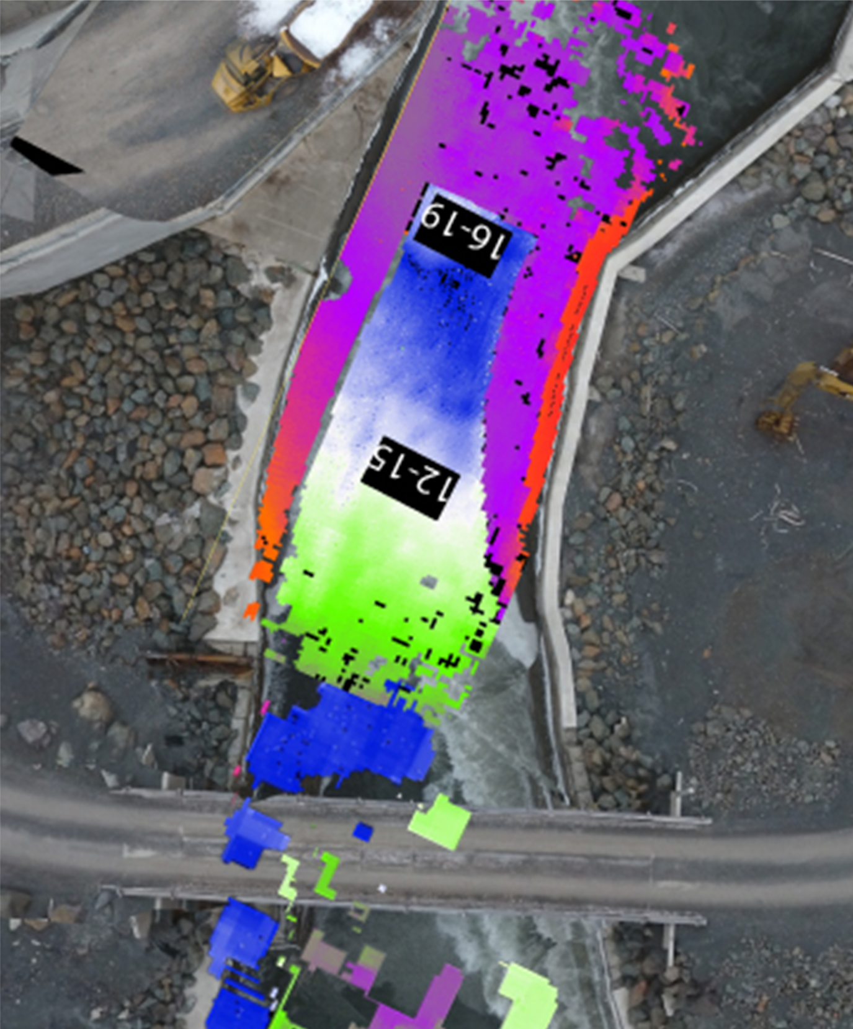
Siltation Management of Dam Reservoirs through Dredging
Photo credit: Northwest Hydraulic Consultants
Konrad Mech
Sales Director, Coasts, Ports and Inland Waterways

Slide 2
Presentation Flow:
Key Issues in Reservoir Dredging
Factors Affecting Acoustic Instruments – A Review
Real Time Dredge Monitoring Using Acoustics
Case Study 1: Run of River Hydroelectric Reservoir Siltation Management
Case Study 2: Run of River Hydroelectric Reservoir Siltation and Trash Monitoring
Case Study 3: Reservoir Siltation Over Time
Case Study 4: Surgical Dredging: Mechanical Backhoe Dredge Monitoring
Case Study 5: Surgical Dredging: Clam Shell Dredge Monitoring

Slide 3
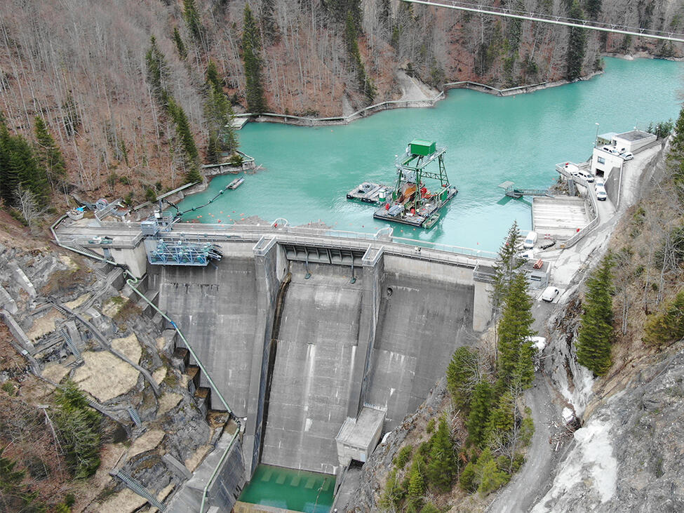
Key Issues in Reservoir Dredging
Sediment Management Strategies
Reduce sediment yield
Route incoming sediments
Remove or redistribute sediments
  Dredging
Adaptive Strategies

Slide 4
Key Issues in Reservoir Dredging
Reservoir Dredging: A Practical Overview (WEDA Technical Report, April 2021)
Use when drawdown is undesirable
  may degrade downstream channel
  impact to fish and wildlife habitat
  Potential damage to riverside infrastructure and property
Human error to blame for release of water at Cleveland Dam that left two dead
Metro Vancouver says last Thursday's spill at the Cleveland Dam was caused by a human error related to programming of the control system for the spillway gate.
Source: Vancouver Sun, Oct 8, 2020

Slide 5
Key Issues in Reservoir Dredging
WEDA’s Technical Report: “Reservoir Dredging: A Practical Overview”; WEDA, 2021
Reservoir location, accessibility
  Dredge transport costs
Volume, physical layout of material to remove
  Bathymetric survey
  Vessel accessibility
Water depth
  mechanical or hydraulic dredge
Material types and processing
  mechanical or hydraulic dredge
Potential damage to structure (surgical dredging)
Transport and final disposition
  Potential economic value of material (cost offset)

Slide 6
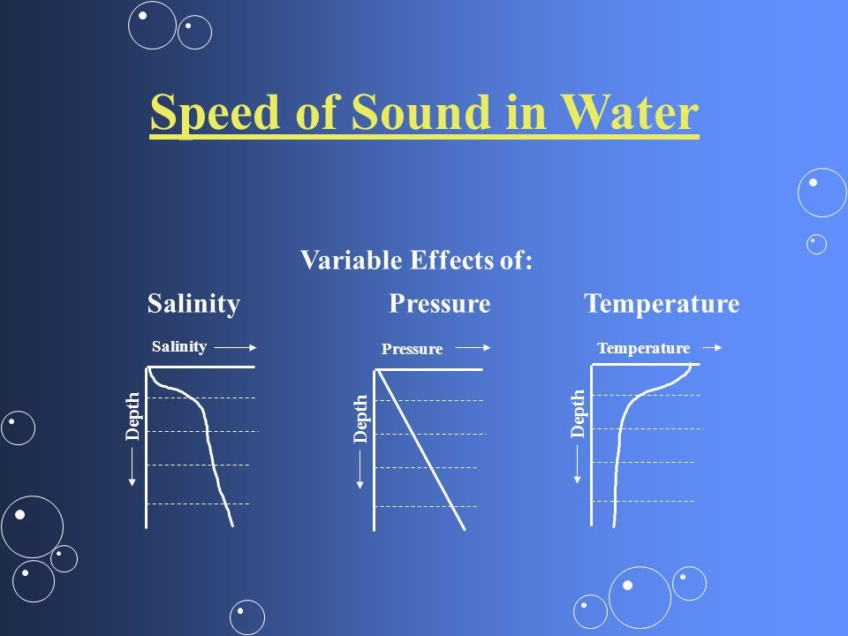
Factors Affecting Acoustic Instruments – A Review
Frequency / Range / Turbidity
Low frequency = long range, low resolution,
good penetration
High frequency = short range, high resolution,
signal attenuation
Temperature Differential in Water Column
High T distorts signal path
Salinity (seawater incursion near coasts?)
Beam Width ~ Cost

Slide 7
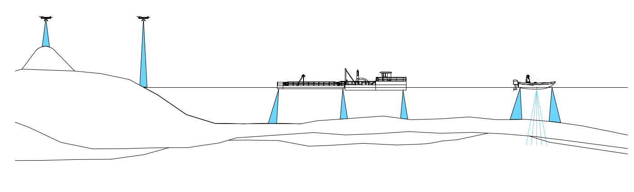
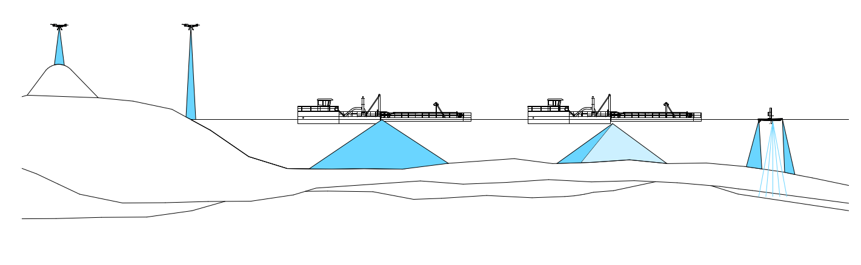
Real Time Dredge Monitoring Using Acoustics
6.1 Anticipated Key Areas for Innovation Focus
When?
What is the trigger to dredge?
What?
Periodic survey
Real time siltation monitoring
Real-time dredge monitoring
Post-dredge survey
How?
Manned survey vessel
Unmanned survey vessel
On the dam structure
On the dredge itself
What technology?
Single beam echosounder
Multibeam echosounder
Fixed, dual axis sonar

Slide 8
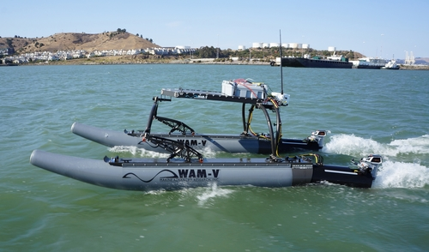
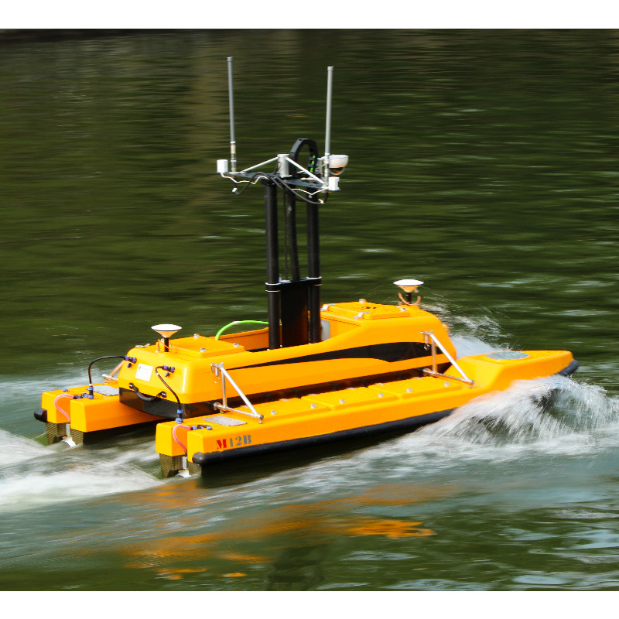
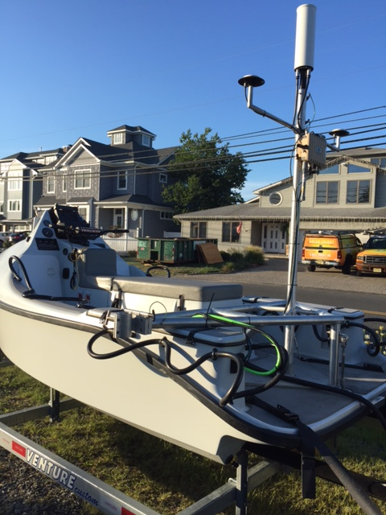
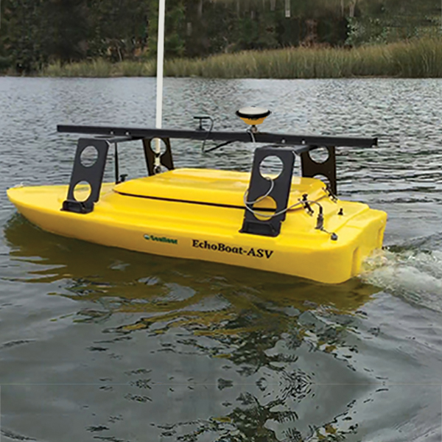
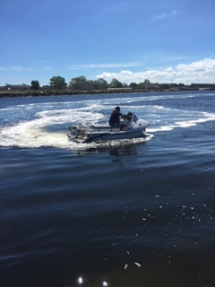
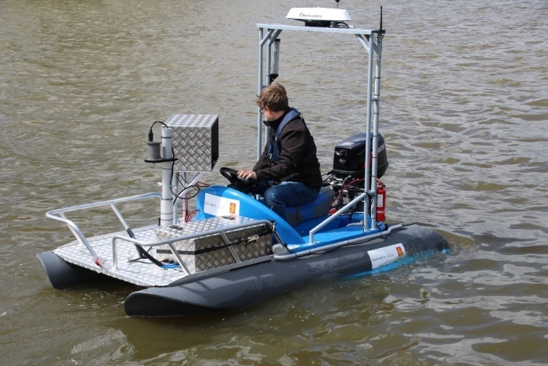
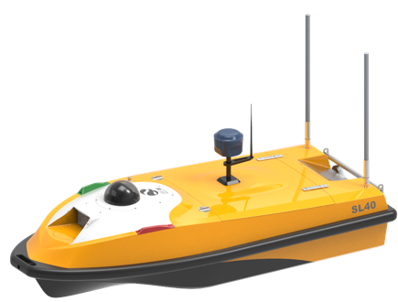
Shallow Survey USV/ASVs

Slide 9
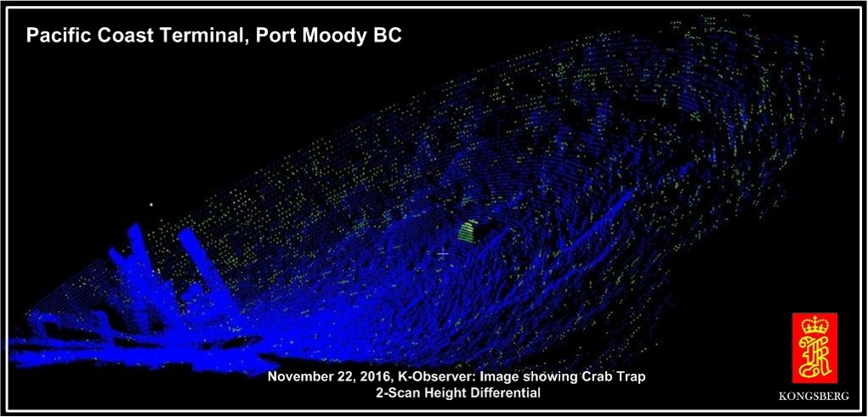
Dual Axis Sonar – Fixed, Continuous Operation

Slide 10
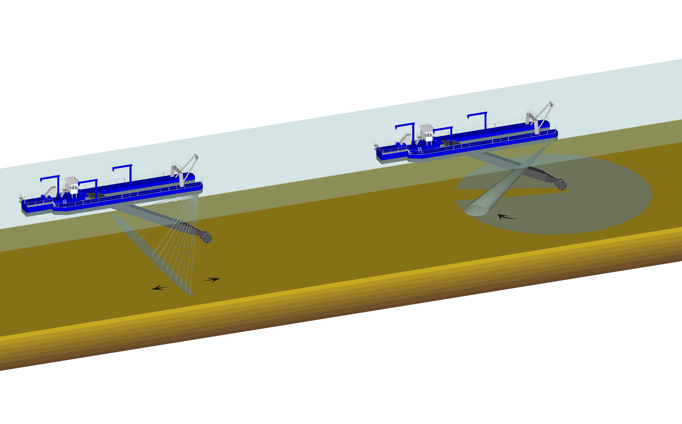

Slide 11

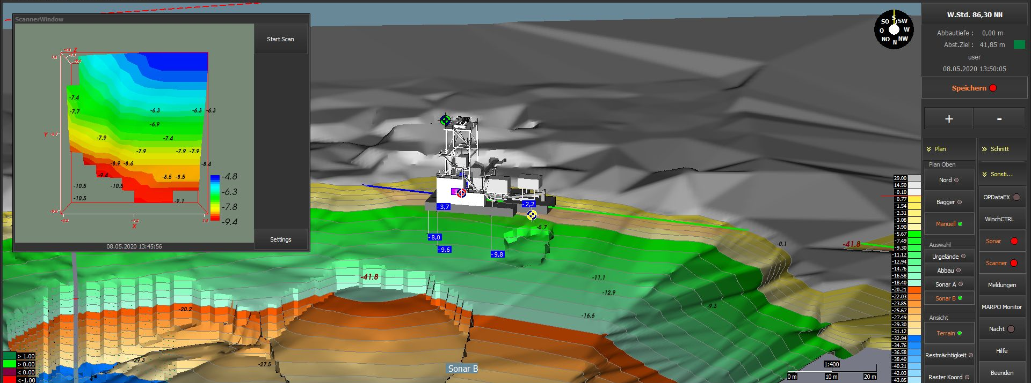
SPE Optionen
DAS (360° Scanner Dual-Axis-Sonar)

Slide 12
Acknowledgements – Case Studies 1, 2 and 3
Andre Zimmermann, Principal Geomorphologist, Northwest Hydraulic Consultants,
Vancouver, BC, azimmermann@nhcweb.com
Jose Vasquez, Principal, Northwest Hydraulic Consultants, Vancouver, BC,
jvasquez@nhcweb.com
Dan Haught, Fluvial Geomorphologist, Northwest Hydraulic Consultants, Sacramento, CA,
dhaught@nhcweb.com
Achilleas Tsakiris, Hydraulic Specialist, Northwest Hydraulic Consultants, Olympia, WA,
atsakiris@nhcweb.com
Ashley Dudill, Project Engineer, Northwest Hydraulic Consultants, Vancouver, BC,
adudill@nhcweb.com

Slide 13
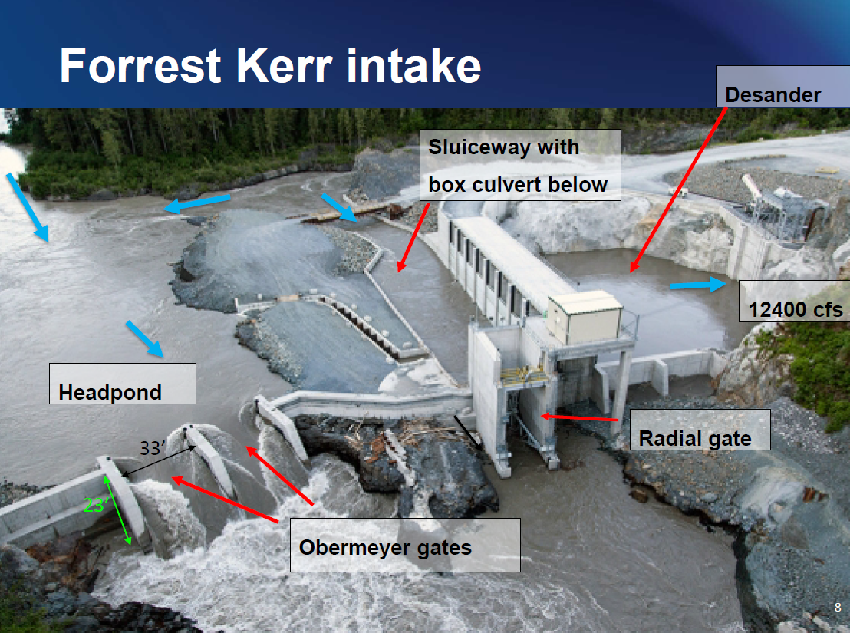
Case Study 1: Run of River Hydroelectric Reservoir Dredging

Slide 14
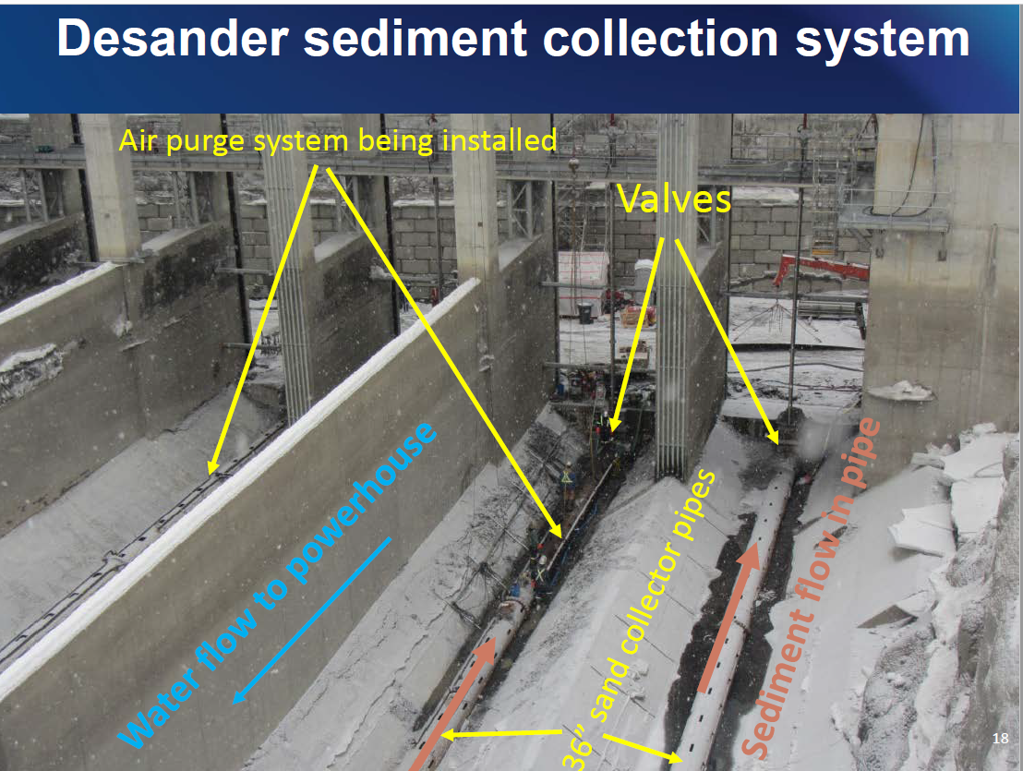
Case Study 1: Run of River Hydroelectric Reservoir Dredging

Slide 15
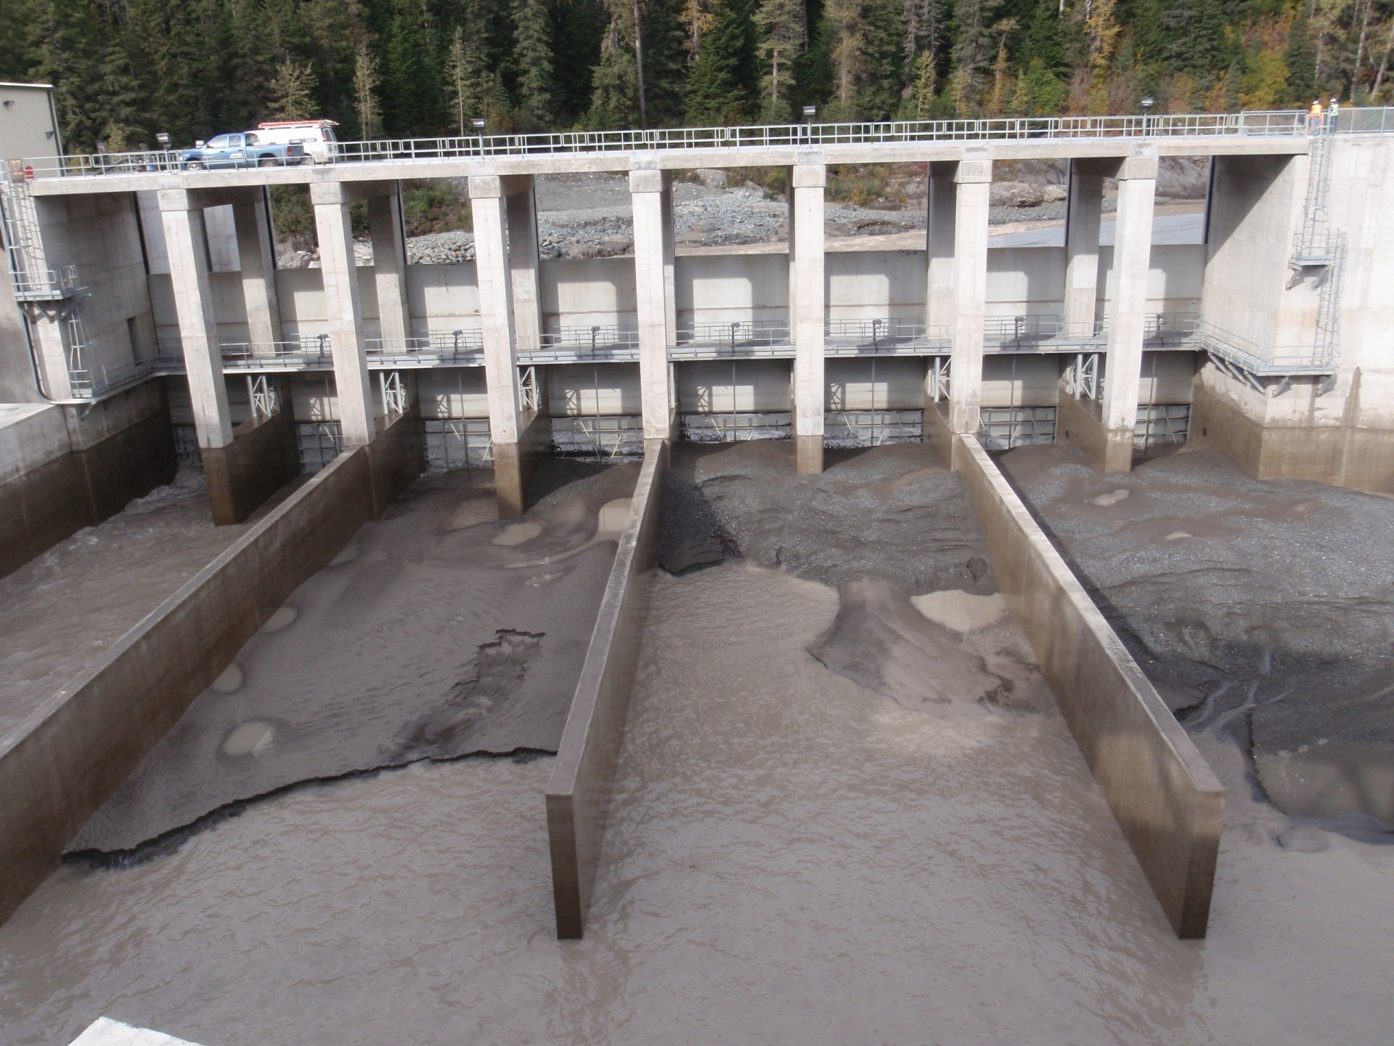
Case Study 1: Run of River Hydroelectric Reservoir Dredging

Slide 16
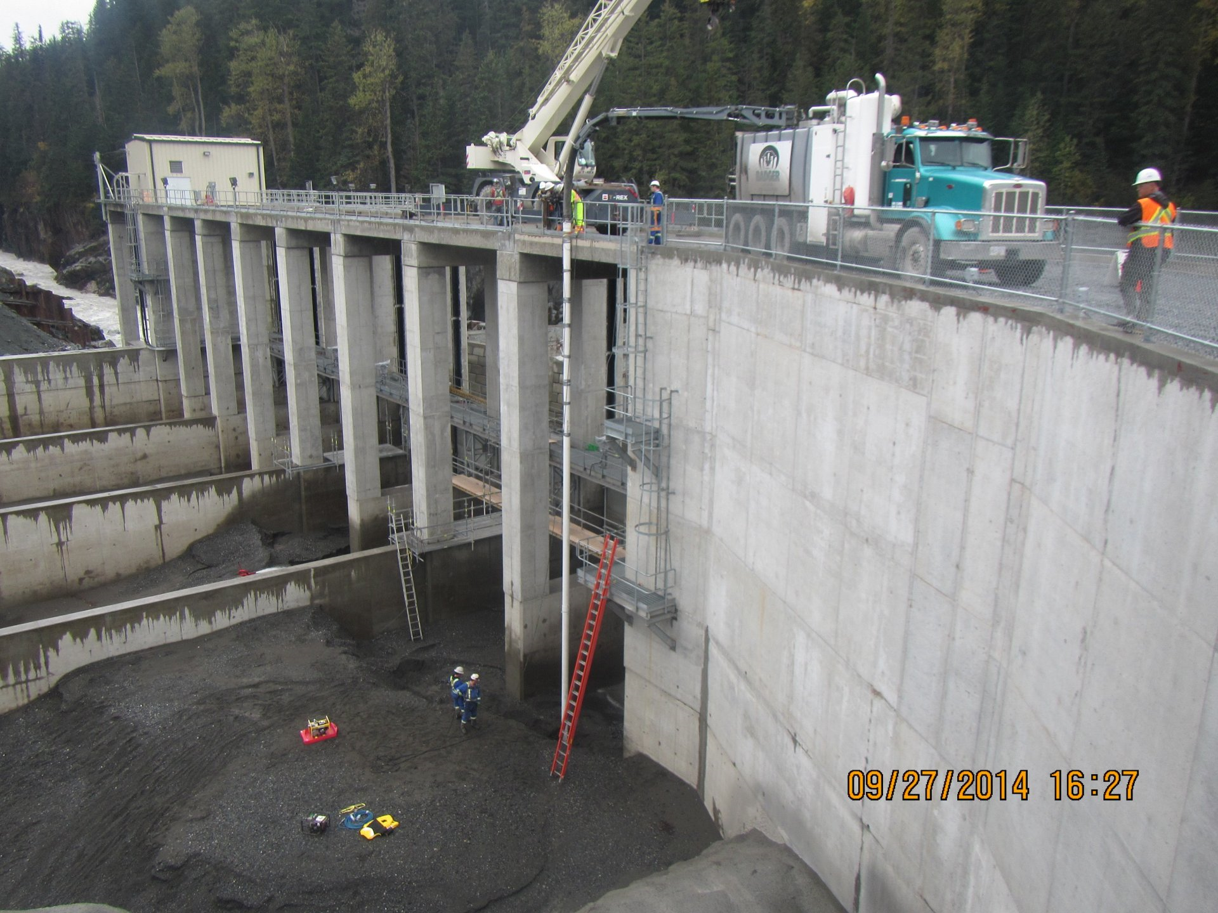
Case Study 1: Run of River Hydroelectric Reservoir Dredging

Slide 17
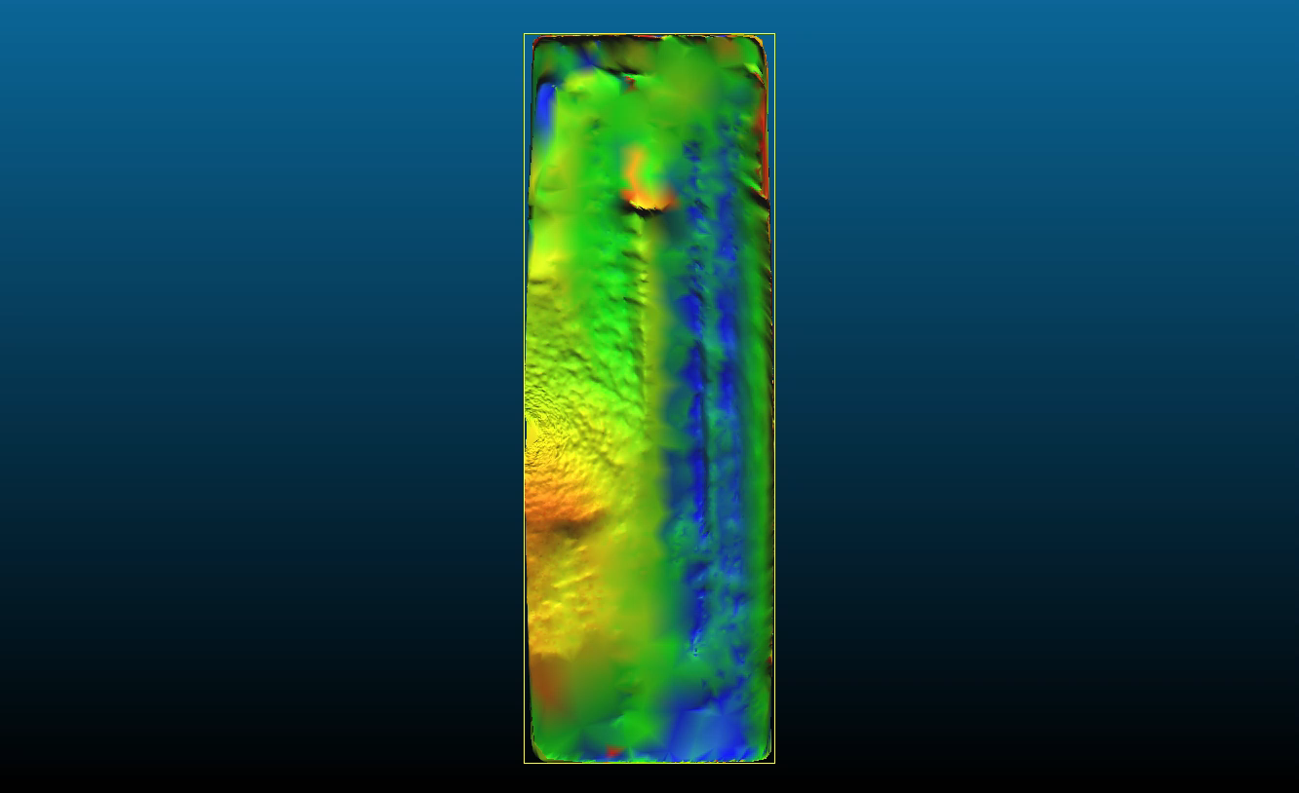
Case Study 1: Run of River Hydroelectric Reservoir Dredging
20 scans within 30 hours, showing sand waves and dredging activity

Slide 18

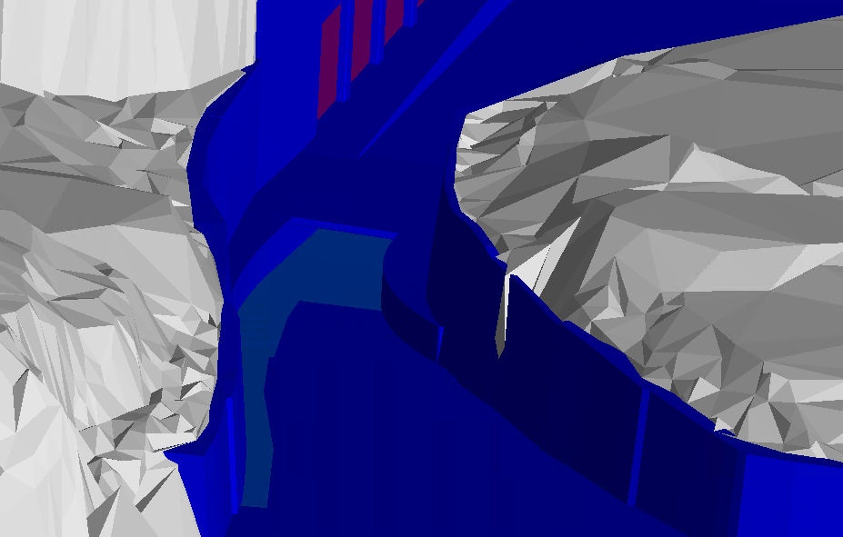
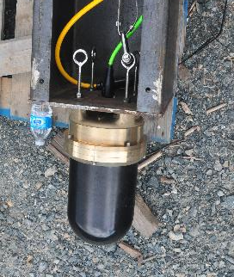
Case Study 1: Dual Axis Sonar in Sluiceway
Records bed elevation in turbid water that is fast flowing and has some air

Slide 19
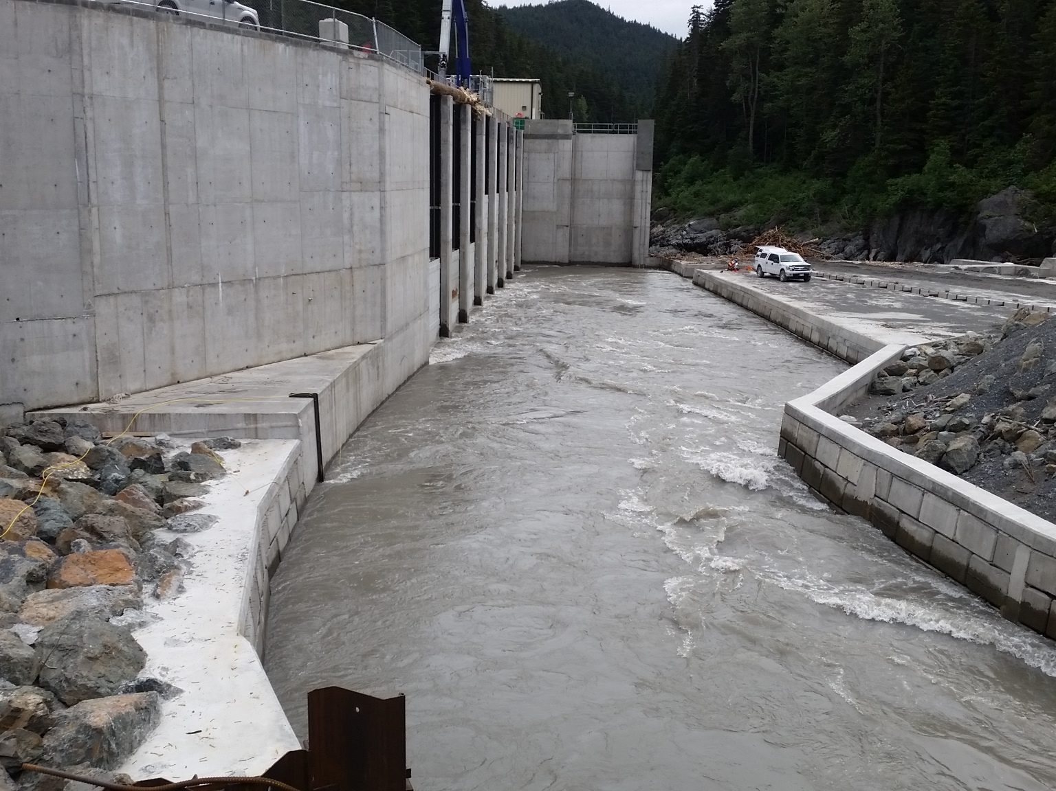
Case Study 1: Dual Axis Sonar in Sluiceway
Sonar mount

Slide 20
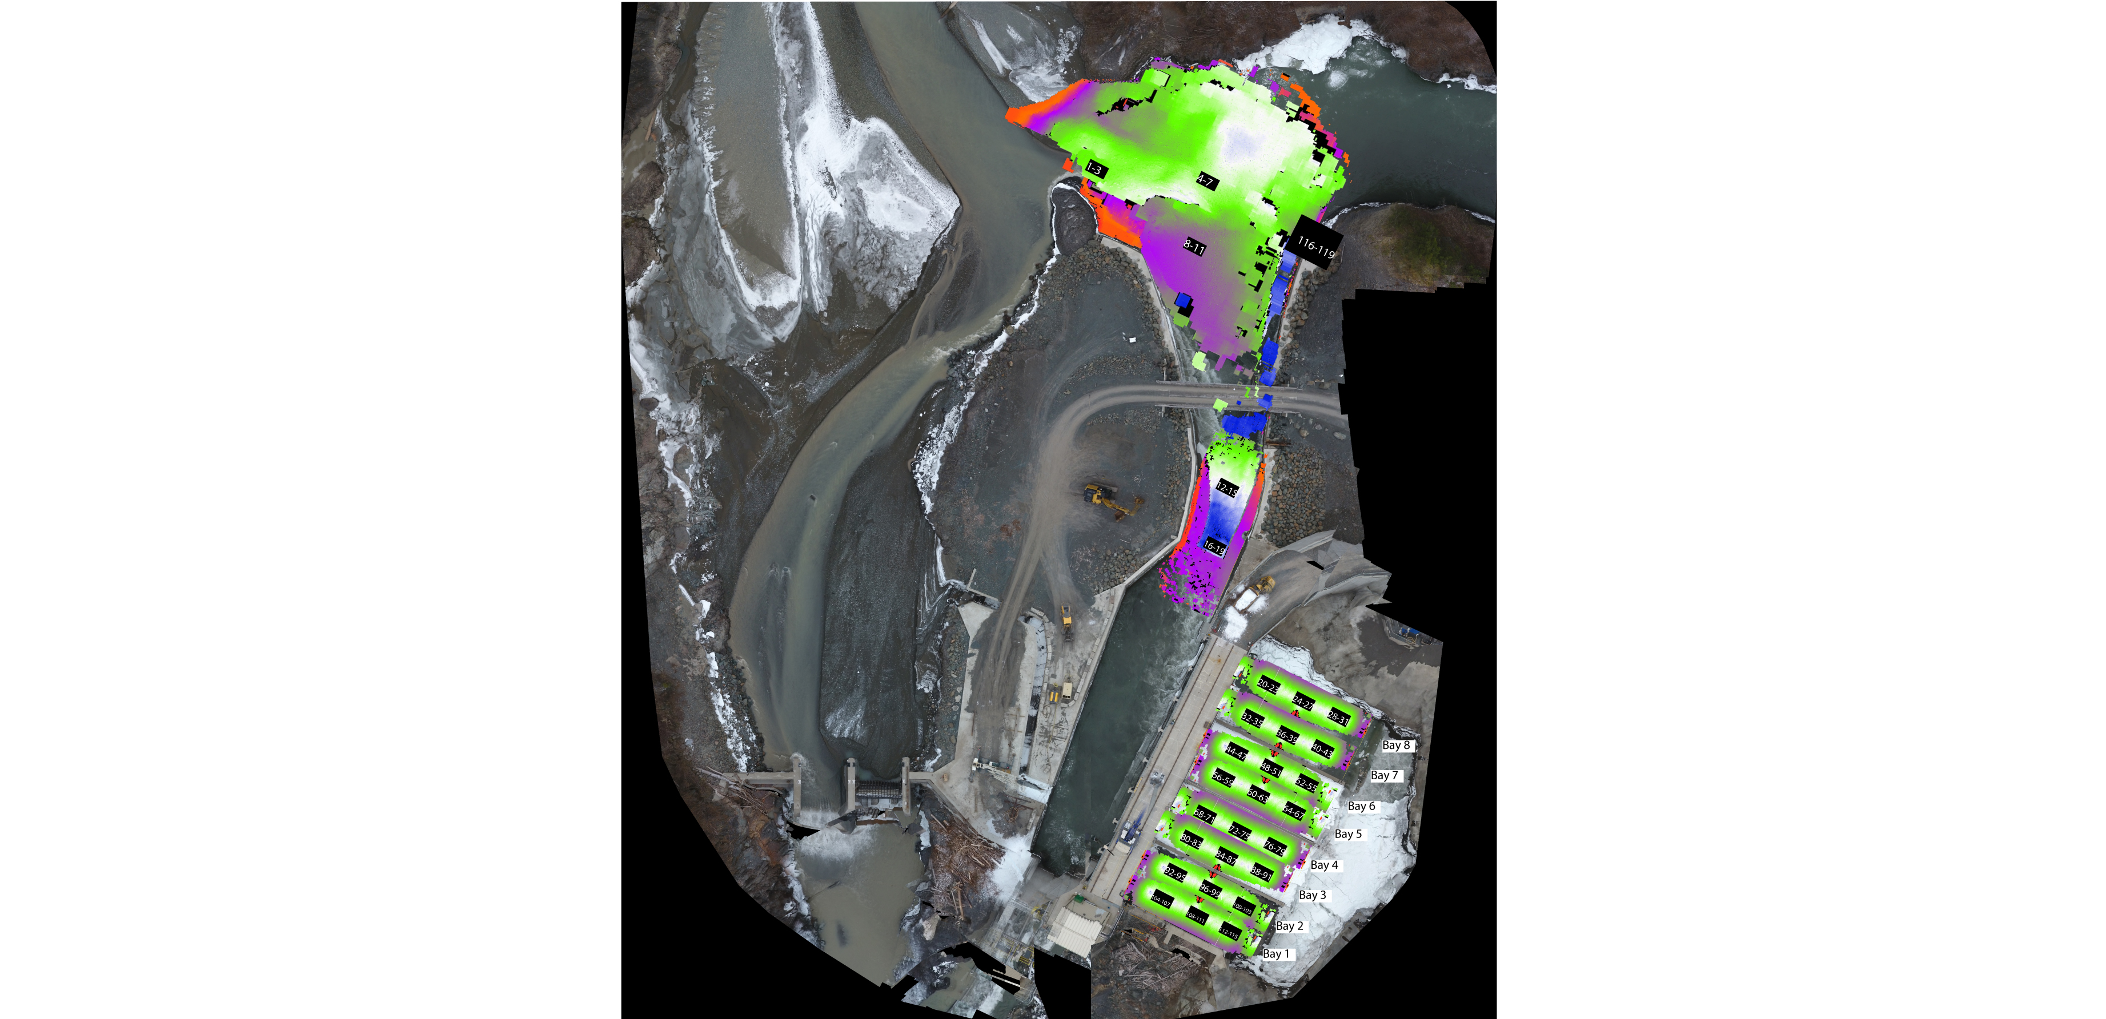
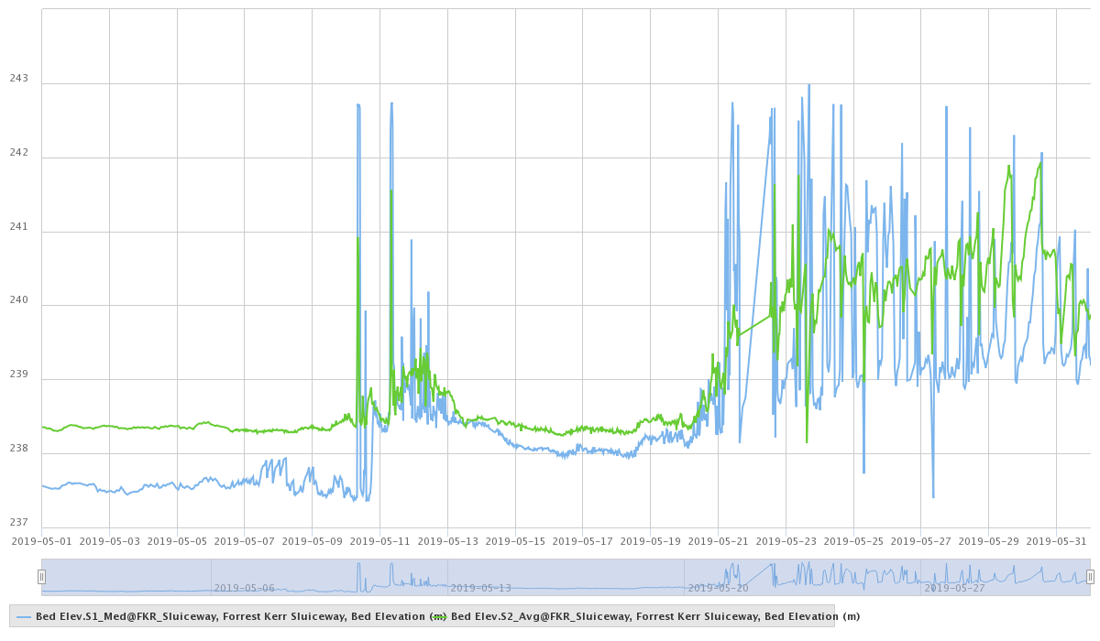
Sonar data goes to control room to be monitored in real-time
Case Study 1: Dual Axis Sonar in Sluiceway
Elevation 1
Elevation 2

Slide 21
Case Study 2: Run of River Hydroelectric Reservoir
Siltation and Trash Monitoring
Cowlitz Falls is located in Southwestern Washington and operated by Lewis County Public Utility District (LCPUD)

Slide 22
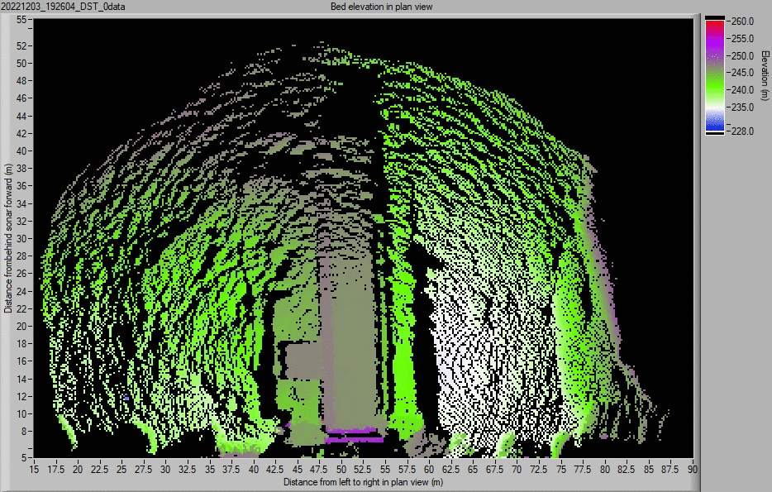
Case Study 2: Run of River Hydroelectric Reservoir
Siltation and Trash Monitoring
Cowlitz Falls is located in Southwestern Washington and operated by Lewis County Public Utility District (LCPUD)

Slide 23
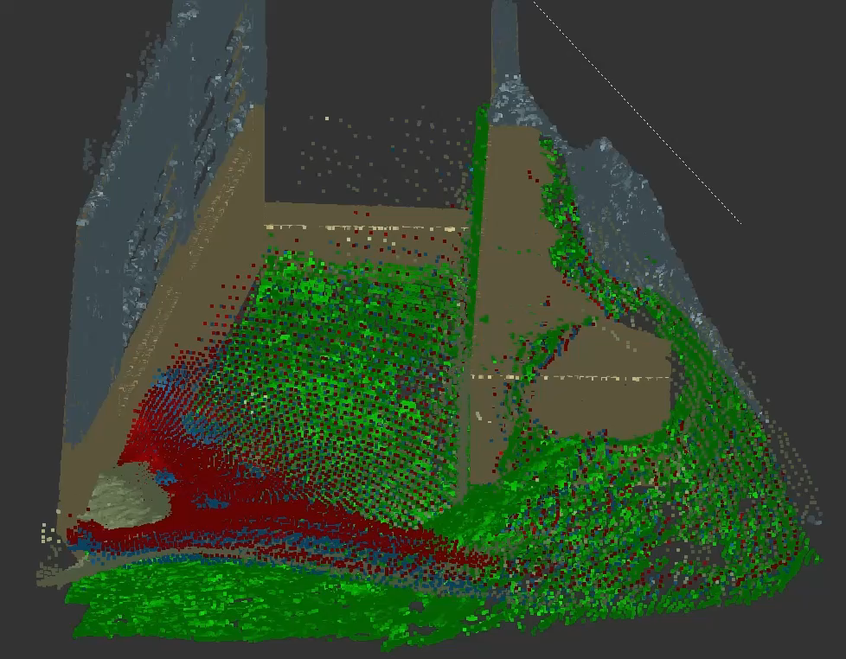
Case Study 3:
Siltation Over Time

Slide 24
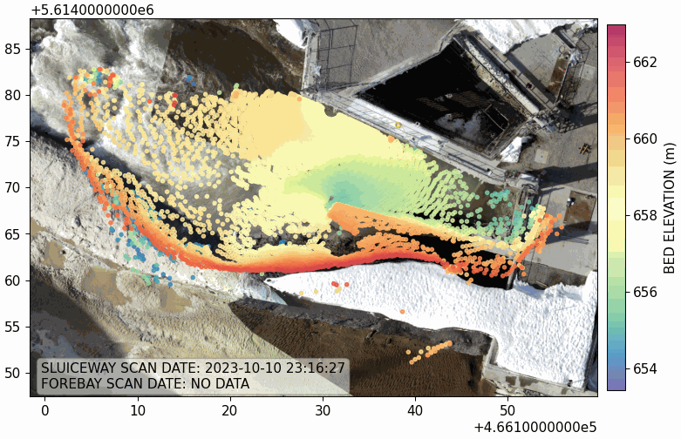
Case Study 3:
Siltation Over Time

Slide 25
Acknowledgements – Case Studies 4 and 5
Peter Klemp, Managing Director, SPE GmbH, Hamburg, Germany,
klemp@spe-electronics.de
Suzanne Coers, Project Manager, SPE GmbH, Hamburg, Germany,
coers@spe-electronics.de
Ilona Schutter, Surveyor, SPE GmbH, Hamburg, Germany,
schutter@spe-electronics.de

Slide 26
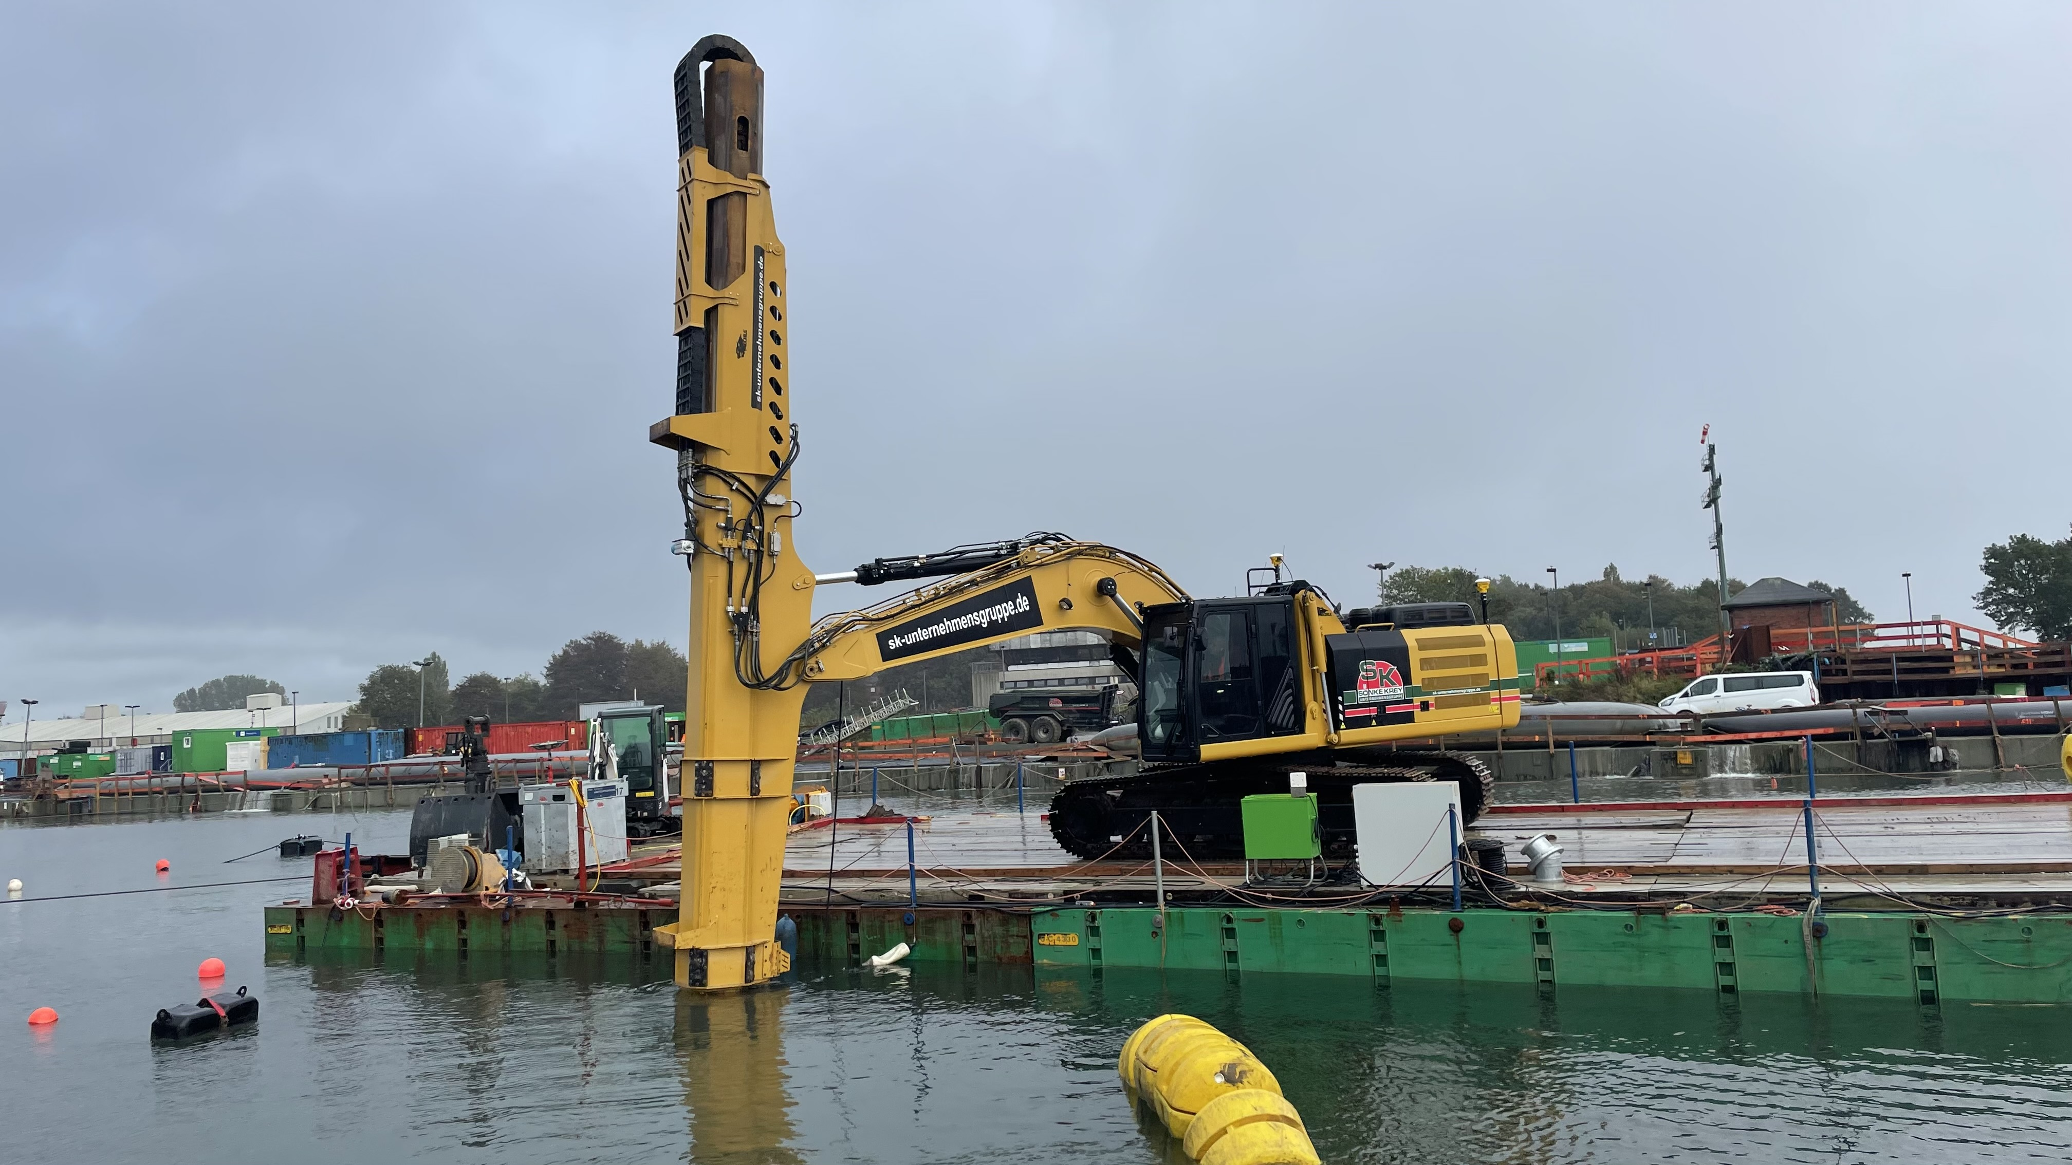
Case Study 4: Mechanical Backhoe Dredge Monitoring
Surgical Dredging

Slide 27
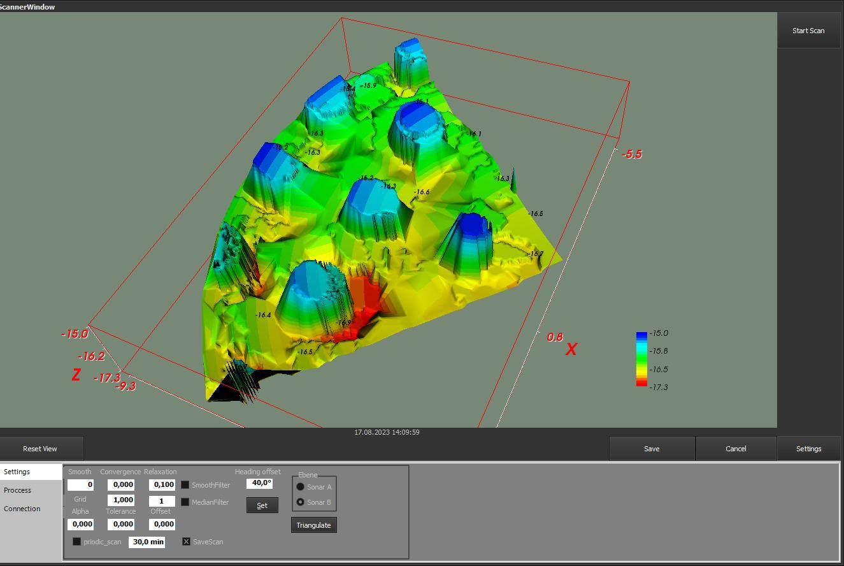
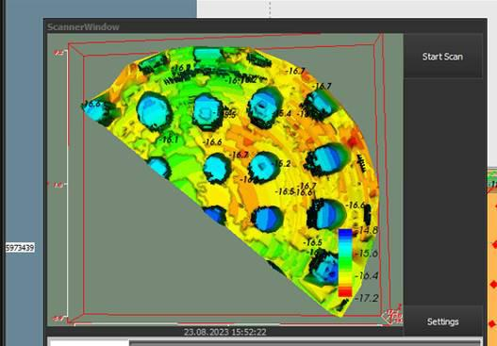
Case Study 4: Mechanical Backhoe Dredge Monitoring
Surgical Dredging now possible in operator’s cab

Slide 28
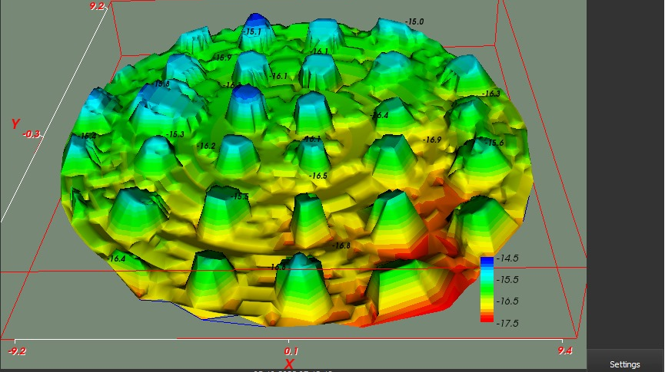
Case Study 4: Mechanical Backhoe Dredge Monitoring
Surgical Dredging now possible in operator’s cab

Slide 29
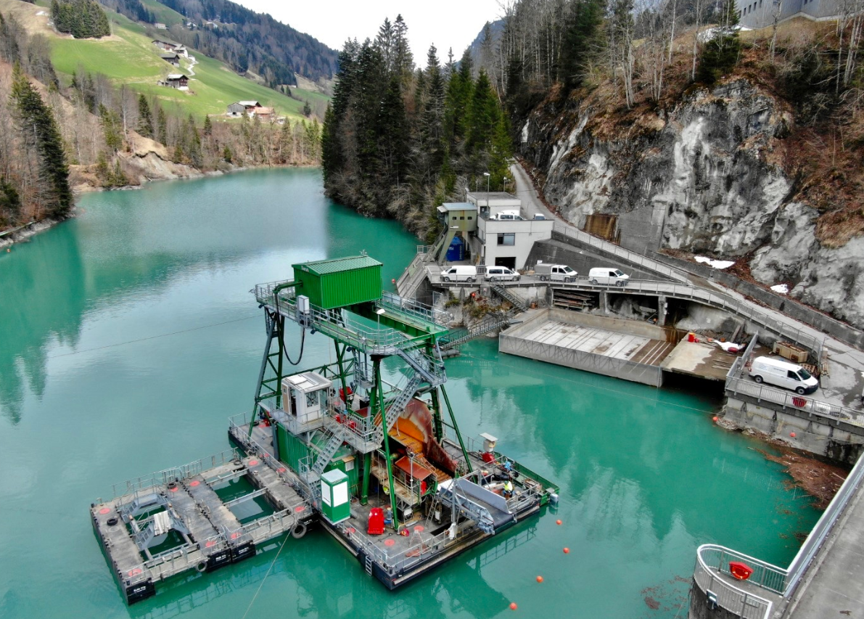
Case Study 5: Clamshell Dredge Monitoring
Surgical Dredging

Slide 30
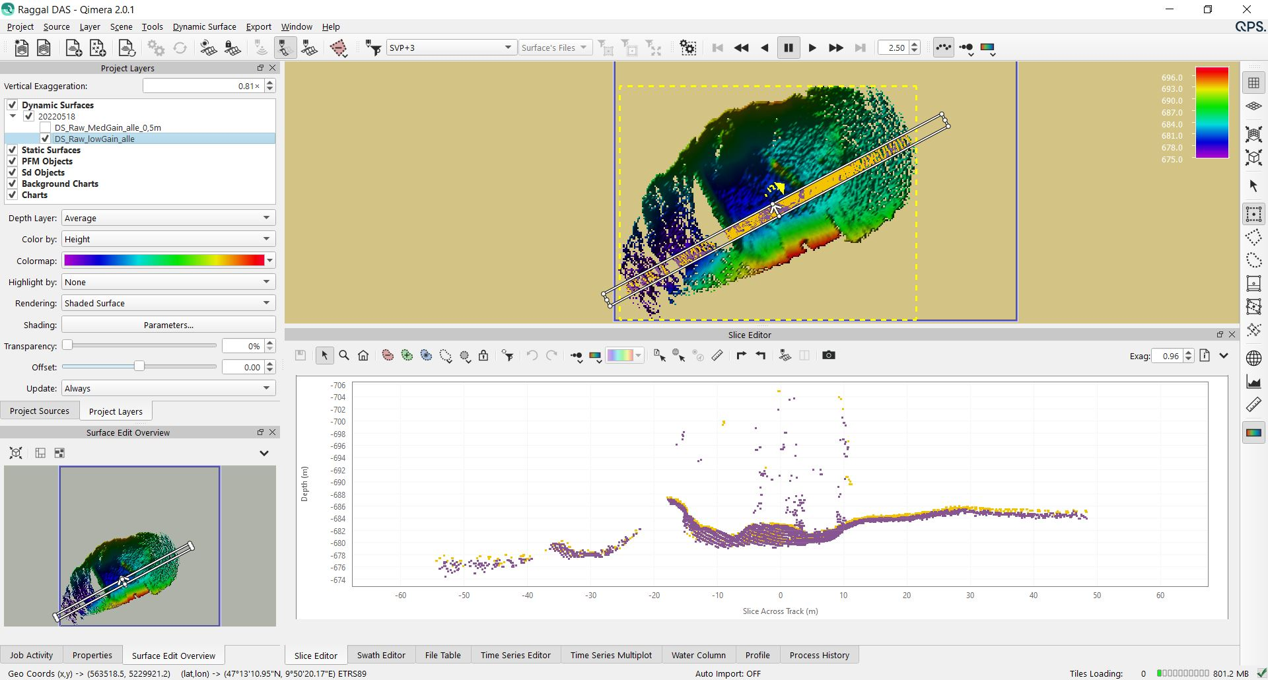
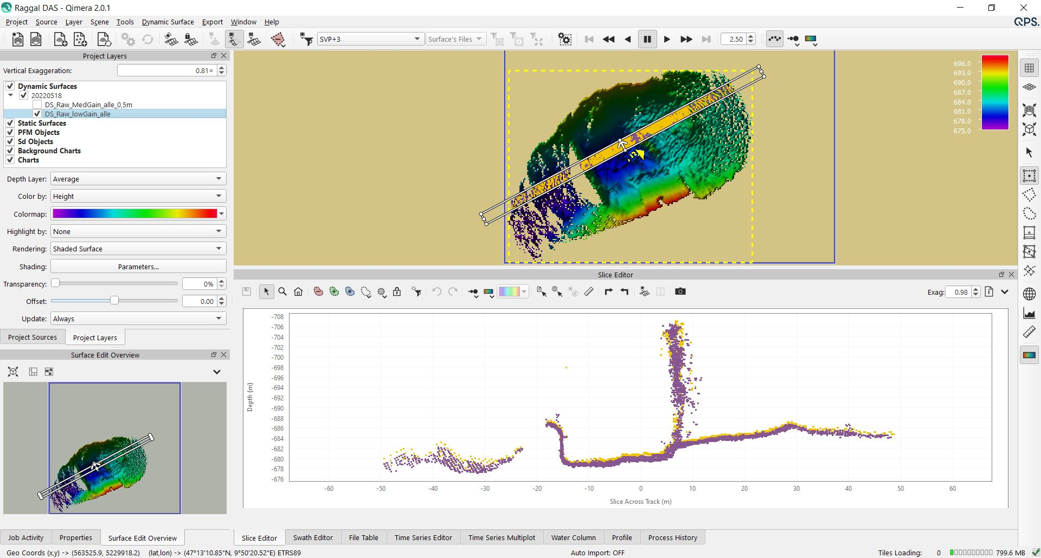
Case Study 5: Clamshell Dredge Monitoring
Surgical Dredging

Slide 31
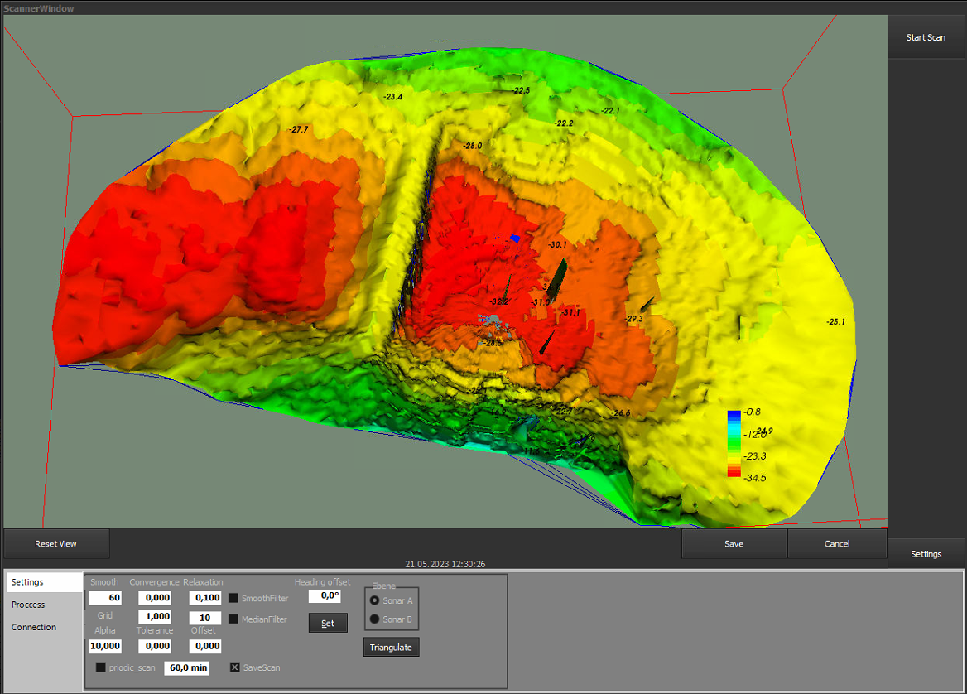
Surgical Dredging
Case Study 5: Clamshell Dredge Monitoring
Beispielhafte Darstellung eines Scans im Marpo_Scanner ohne Filter.

Slide 32
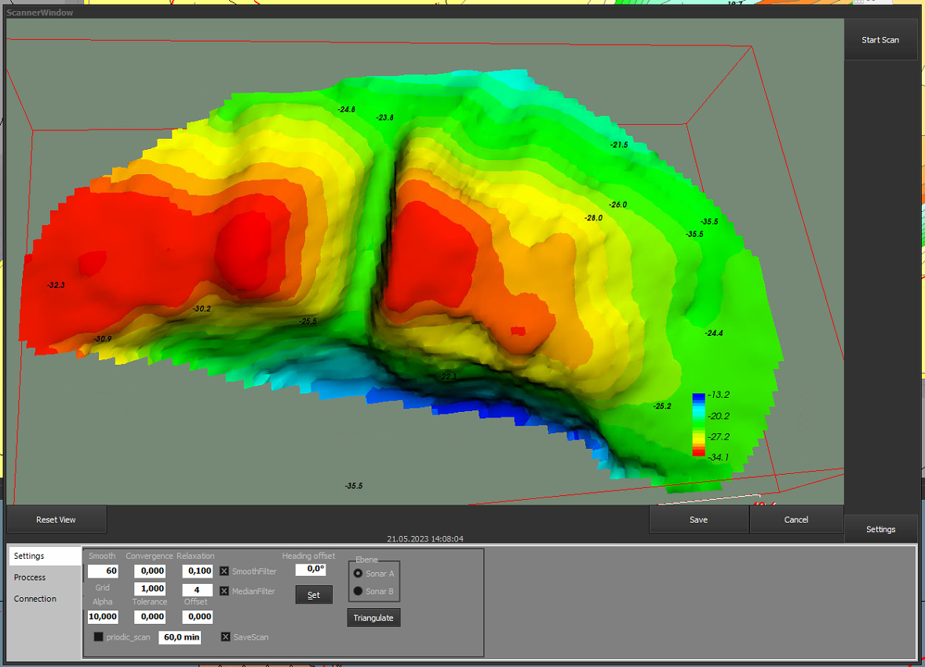
Surgical Dredging
Case Study 5: Clamshell Dredge Monitoring
Beispielhafte Darstellung eines Scans im Marpo_Scanner mit Filter.

Slide 33
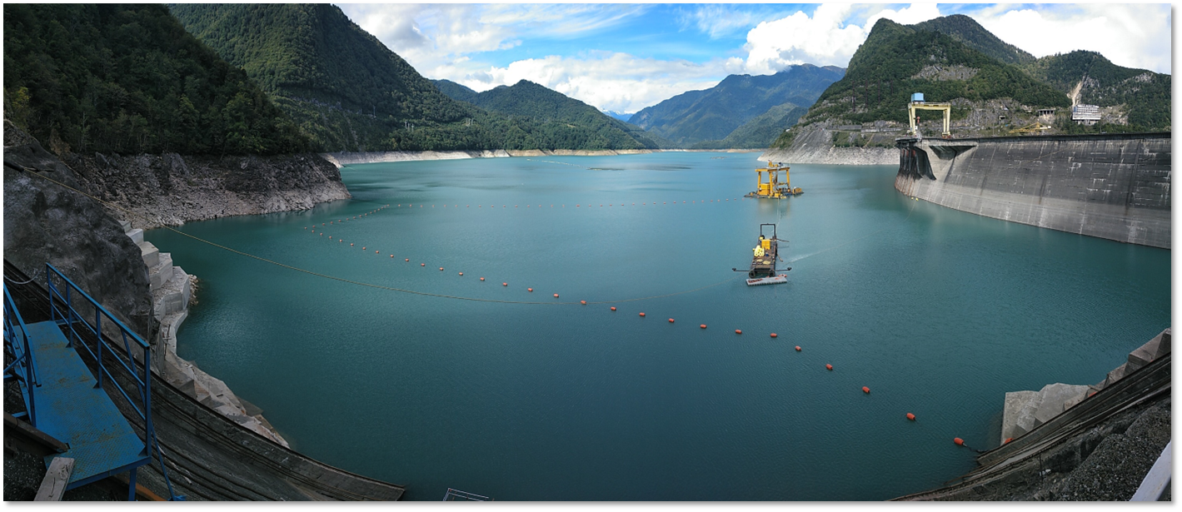
Summary
Siltation Management of Dam Reservoirs through Dredging
Pre- and post-dredge survey becoming easier
  Smaller, lighter craft
  Lower cost systems
Real-time monitoring of reservoirs means:
  Mounting fixed sensors on the structure
  Full understanding of rates of siltation
  Trigger for dredge activity to minimize impact on operations
  Increased safety for downstream conditions
Real time monitoring during dredging means:
  Mounting fixed sensors on the dredge platform
  Reduced risk of damage to dam structure
  Increased operator confidence
  Lower costs due to higher efficiencies

Slide 34
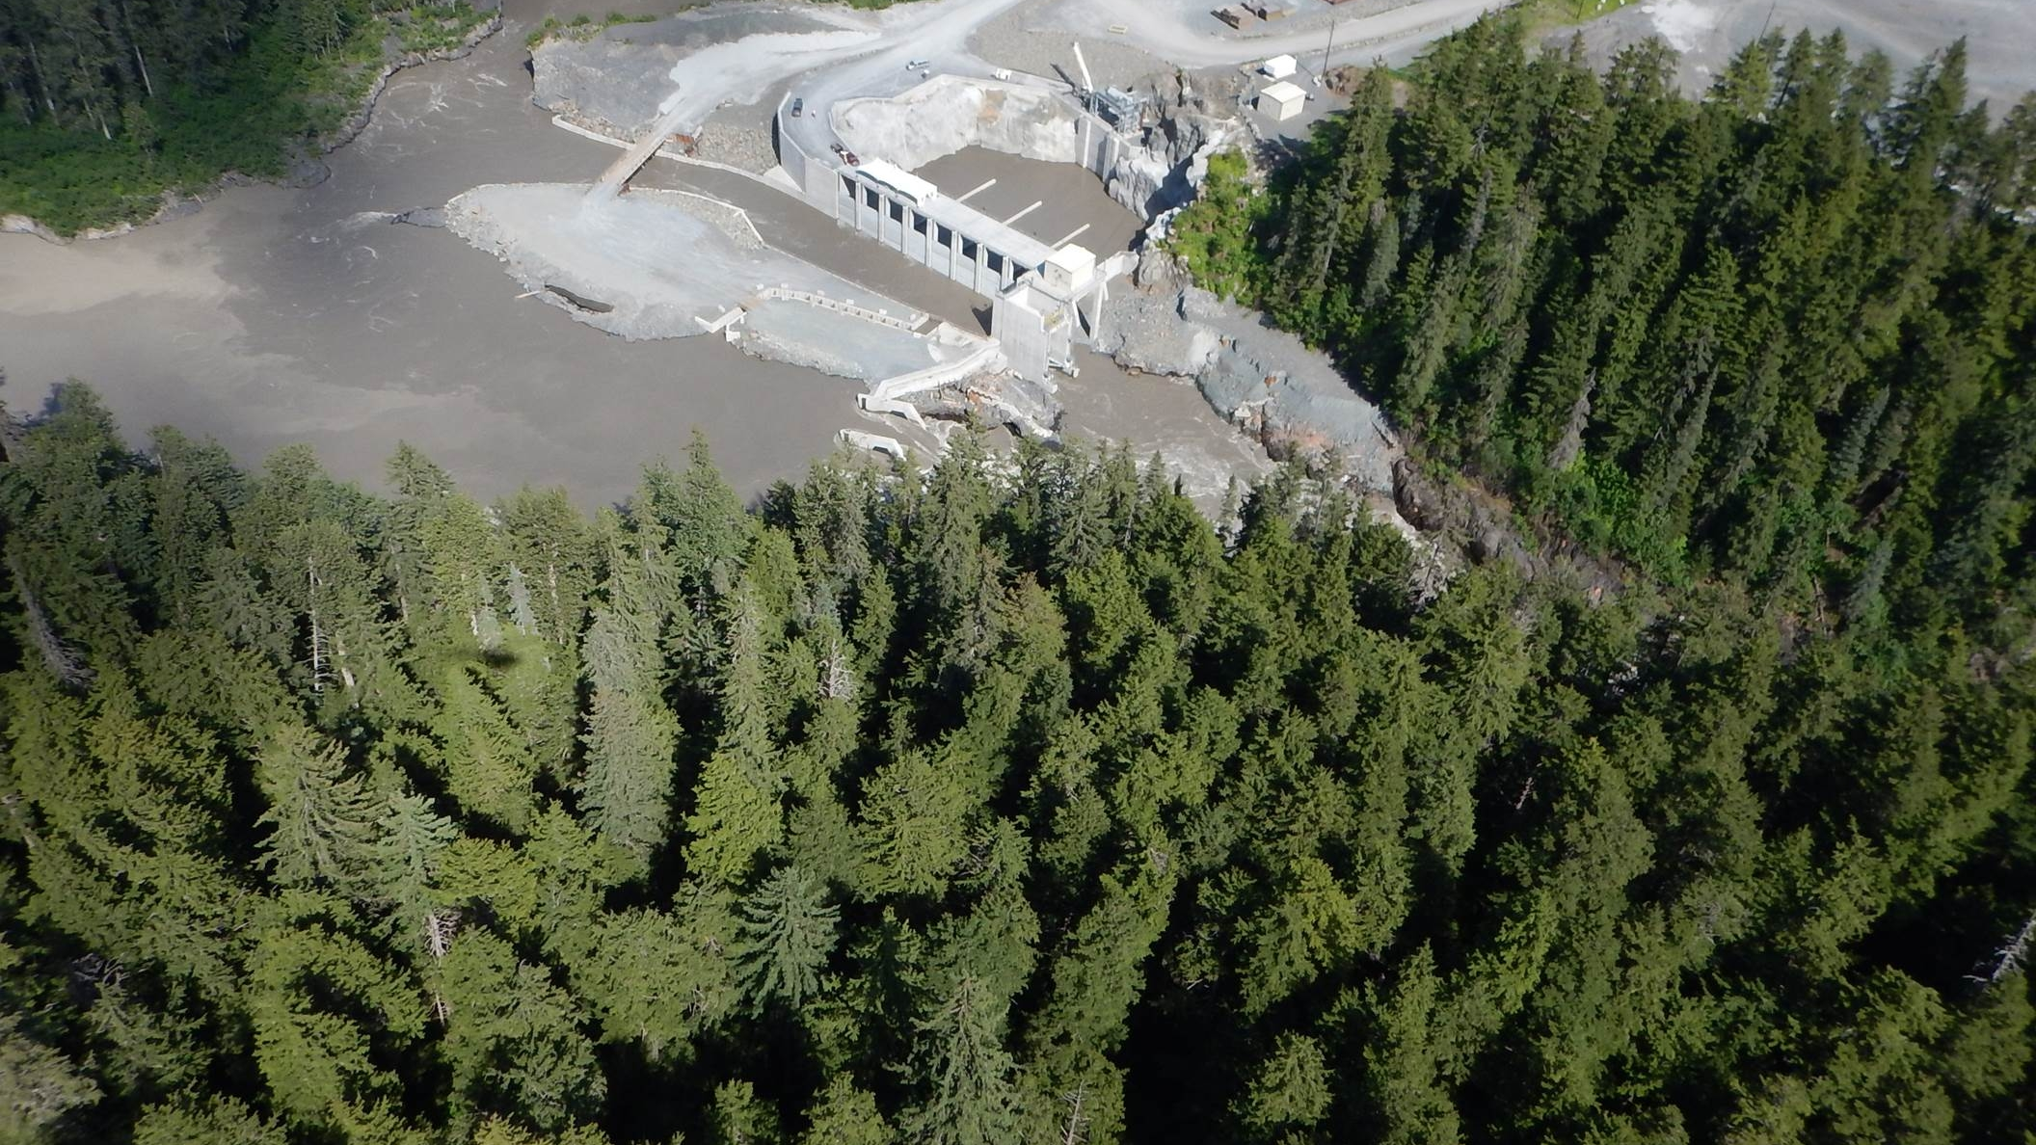
Thank you for your interest.
konrad.mech@kd.kongsberg.com

