Slide 1
NORTHEAST BEACHES 2013
State Boat Channel Emergency Dredging & Beach Fill at Robert Moses State Park
Presented to:
Northeast Shore & Beach Preservation Association
September 10, 2013

Slide 2
Robert Moses Emergency Beach Fill
NYS Parks – OGS
Owner Administration
NYS DEC, USACE
Parsons Brinkerhoff
Permits
Prime Consultant
Grace Industries, LLC
Village Dock, Inc.
Gahagan & Bryant
Truck Haul & Grading
Hyd. Dredging
Boat Channel
Engineering, CM
Plover Monitoring
GPI, Parks Ecological, LLC
NYS DOT
Norfolk Dredging
Tri-Venture (Bove/Tully/Picone)
Hyd. Dredging
Fire Island Inlet
Democrat Pt. Stockpile - Truck Haul

Slide 3
INTRODUCTION
Super Storm Sandy 10-29-12 Damage
Robert Moses Beaches (5 miles), Boardwalk
New York State Boat Channel (shoaling)
Project Locations
The Pre-Construction Process
Emergency Beach Fill Contracts
Owner - NYS Parks, administered by Office of General Services
Village Dock, Inc. – Hydraulic Dredge
Grace Industries, LLC – Truck Haul, Grading Plover Habitat
Other - NYS DOT – Norfolk Dredge - Tri-Venture–Truck Haul
GOAL: Beaches Restored by Memorial Day 2013
Notes:
3.5 million visitors annually at R.M.

Slide 4
CBS Channel 2 NEWS VIDEO CLIP

Slide 5
Boardwalk Damage
Sand eroded away
8 Feet Vertically
Notes:
Millions of CY over about 5 miles - These contracts about xxx cy over about 1 mile

Slide 6
VICINITY MAP
East Northport
Bronx
Port Washington
Manhattan
Deer Park
Queens
Garden City
Brooklyn
Long Beach
Project Area

Slide 7
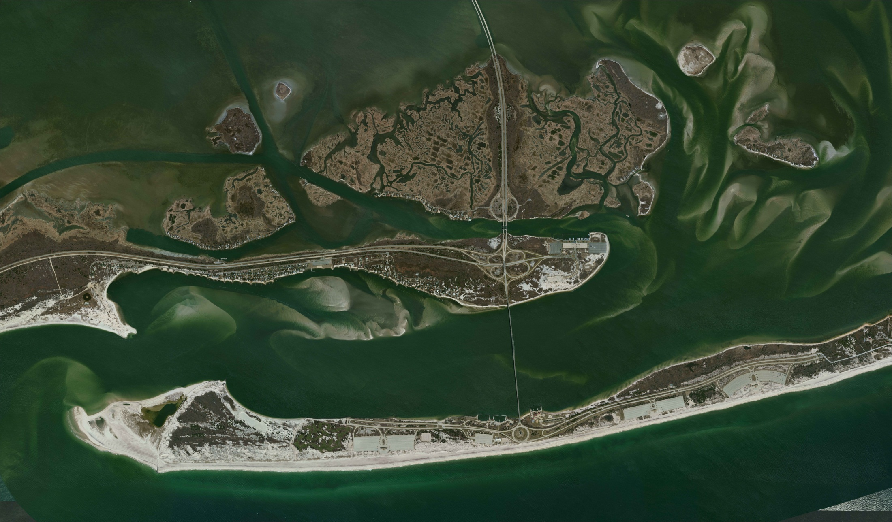
PROJECT AREA
Ocean Parkway
Captree State Park
Fire Island Inlet
Field # 5
Field # 4
Robert Moses State Park
Democrat Point

Slide 8
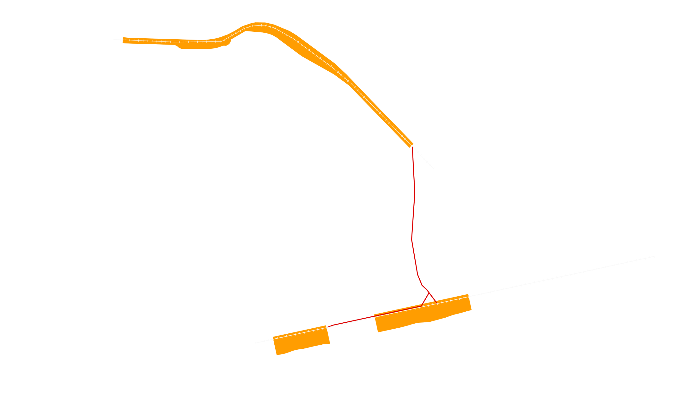
PROJECT LOCATIONS
State Boat Channel Emergency Dredging
Contractor: Village Dock With Hydraulic Dredge
Dredge Pipeline
Emergency Beach Fill
Notes:
Native Beach Fill sand – 0.5 mm medium on the fine side,
Channel sand – 0.4 mm fine sand on the medium side.

Slide 9
PROJECT LOCATIONS
Fire Island Inlet
Grace - Trucking Borrow Area
Democrat Point
Norfolk Dredging Stockpile –
Tri-Venture Trucking

Slide 10
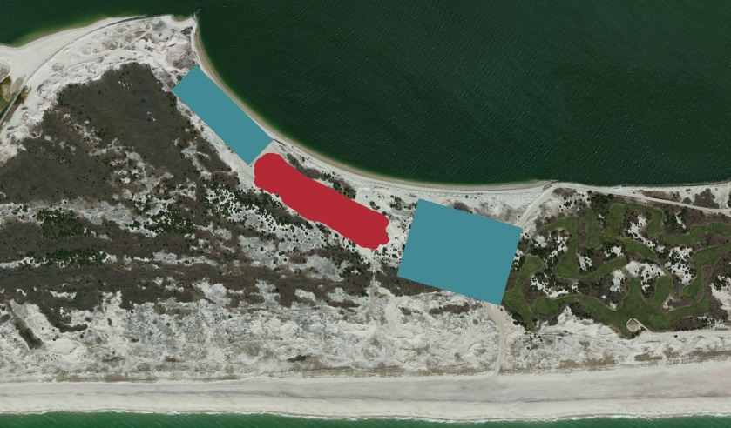
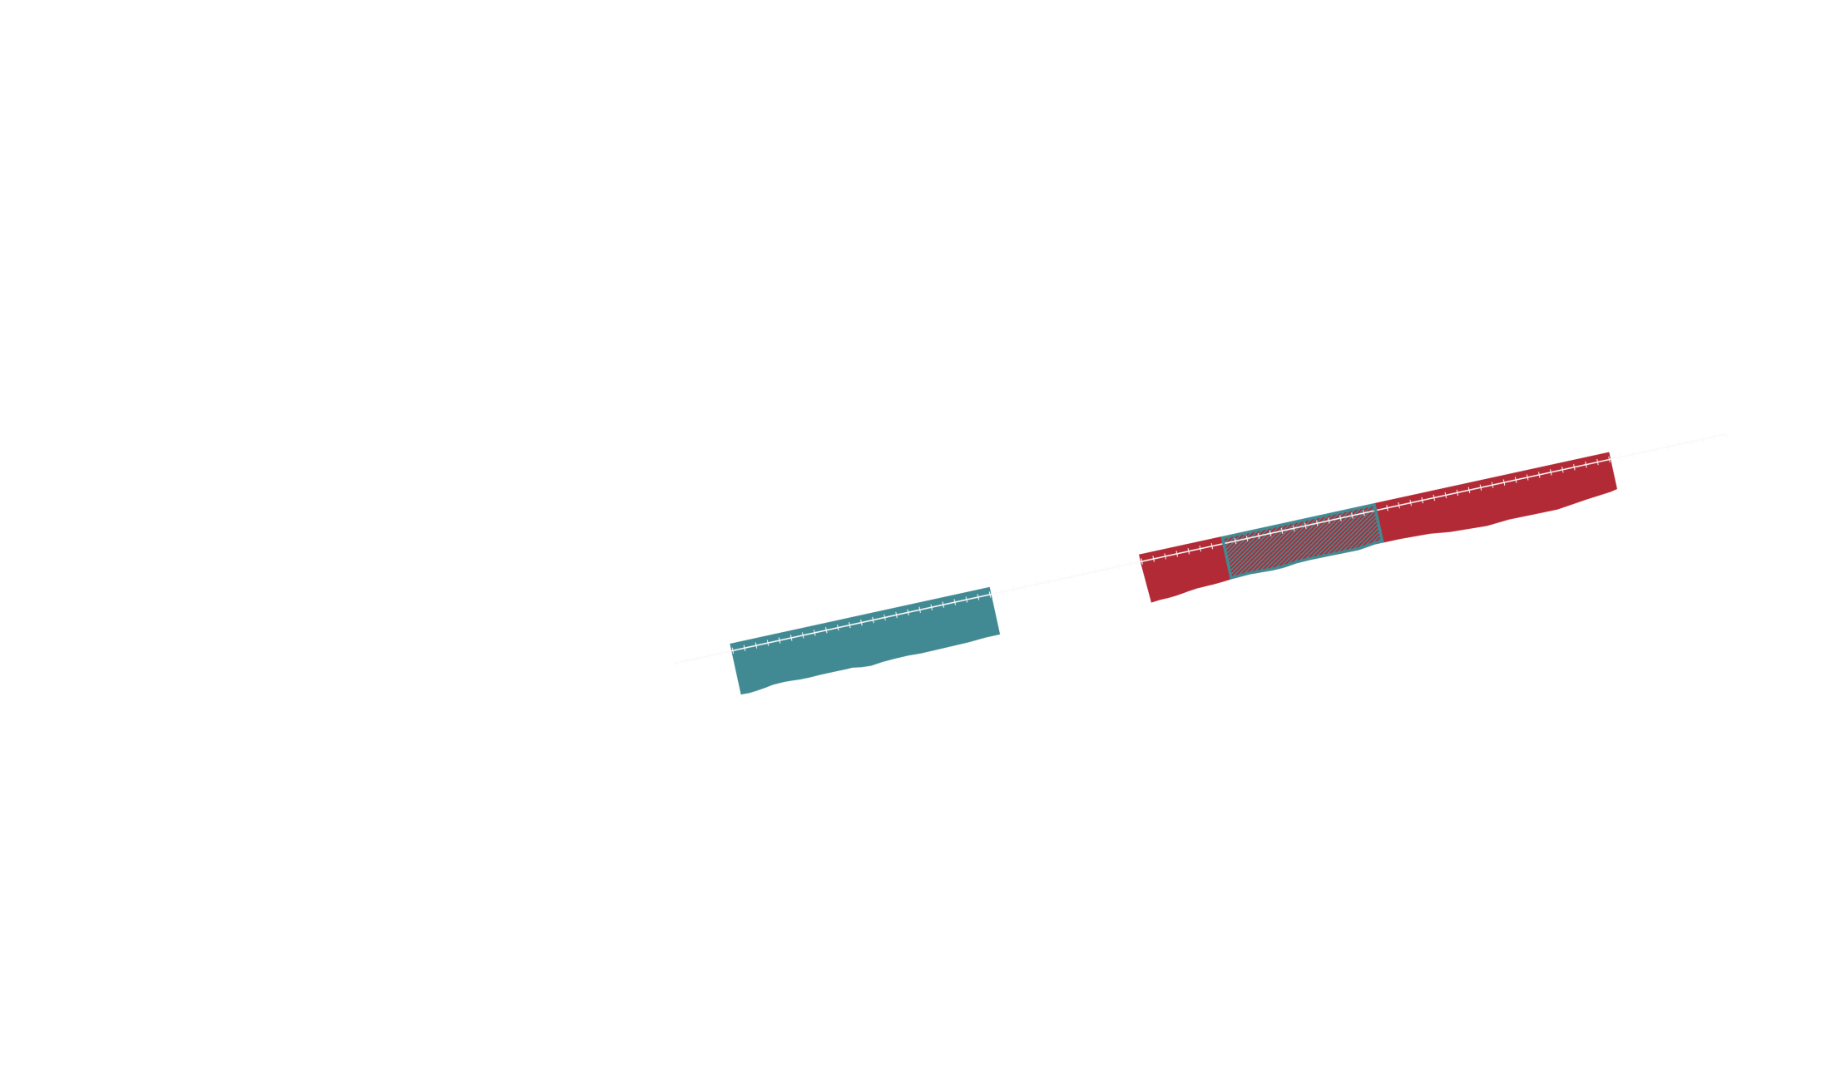
PROJECT LOCATIONS
Grace - Trucking Borrow Area
Norfolk Dredging Stockpile
Field #5
Field #4

Slide 11
TYPICAL PRE-CONSTRUCTION PROCESS
New Permits – NYS DEC, USACE NY District
Planning, sampling, testing, studies, documentation.
Joint Permit, NEPA, Water Quality Cert., Plover windows
Existing Permit Modifications and Approvals
Channel dredging depths and widths
Beach fill locations and geometries
Ingress and egress points to beach & borrow
Planning, design, PSE, Procurement, Bid, Award
Funding

Slide 12
TYPICAL vs. EMERGENCY PROCESS
2013
2014
Jan | Mar | May | July | Sep | Nov | Jan | Mar | May | July | Sep | Nov
Typical Beach Dredging Project Process (2 years +)
12
14 months Planning and Permitting
6 Months Design
4 Months Procure
Emergency Process (2.5 months)
2 Months Planning, Design, Permits
2 weeks Procurement

Slide 13
Robert Moses Emergency Beach Fill
NYS Parks – OGS
Owner Administration
NYS DEC, USACE
Parsons Brinkerhoff
Permits
Prime Consultant
Grace Industries, LLC
Village Dock, Inc.
Gahagan & Bryant
Truck Haul & Grading
Hyd. Dredging
Boat Channel
Engineering, CM
Plover Monitoring
GPI, Parks Ecological, LLC
NYS DOT
Norfolk Dredging
Tri-Venture (Bove/Tully/Picone)
Hyd. Dredging
Fire Island Inlet
Democrat Pt. Stockpile - Truck Haul

Slide 14
BOAT CHANNEL DREDGING
Planning and Design – Jan and Feb 2013
Solicitation Dates - Feb 16 - Feb 19, 2013
Pre Bid Conference Call - Feb 18
Bid Date Feb 19, 2013
Notice to Proceed Feb 20, 2013
Start Dredging March 5, 2013
Finish Dredging May 15 (Beach) - June 6, 2013
Memorial Day May 27
Stock Pile at Berm

Slide 15
BOAT CHANNEL DREDGING
Village Dock, hydraulic dredge - Scrod II – 16 inch
Dredge 1100hp, booster pump 800hp
8,000 ft. channel, 160 ft./day, 4260 cy/day, 385,000 cy
Pipeline length 7,000 to 12,500 ft.
Placement at Fields 4 & 5
Engineering During Construction
Quantities and channel depths/widths modified
Permit modifications
Multiple re-designs
Inspection, Hydrographic Surveys, Measurement & Payment

Slide 16
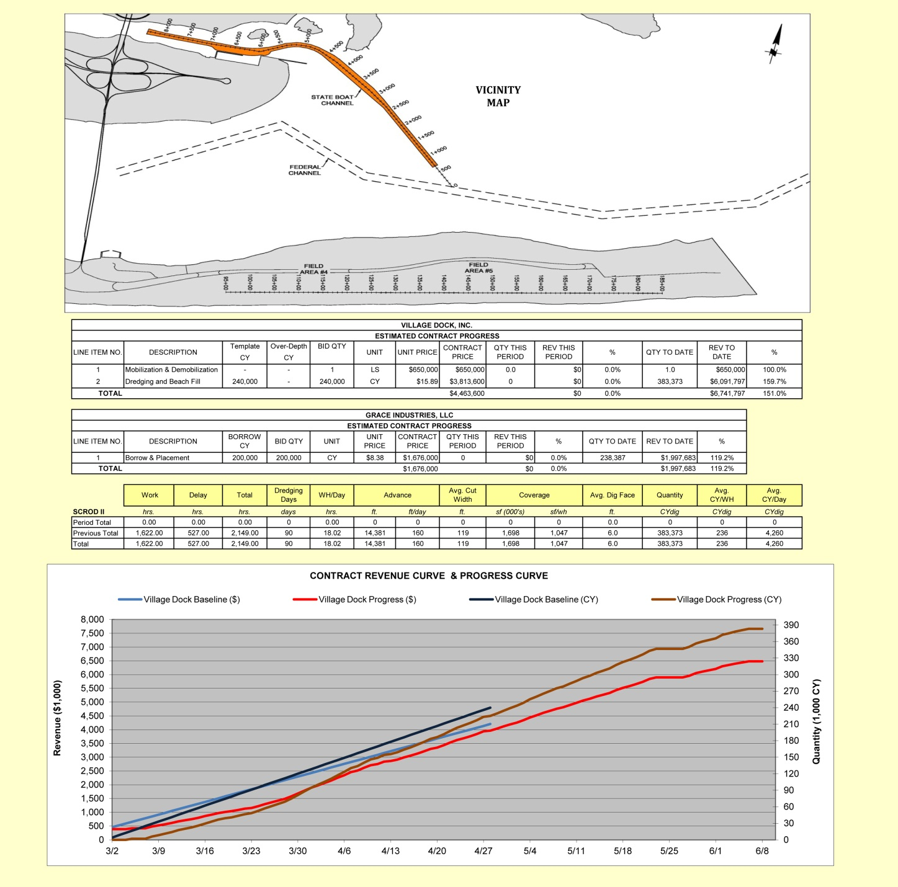
Excerpts from Weekly Reports

Slide 17
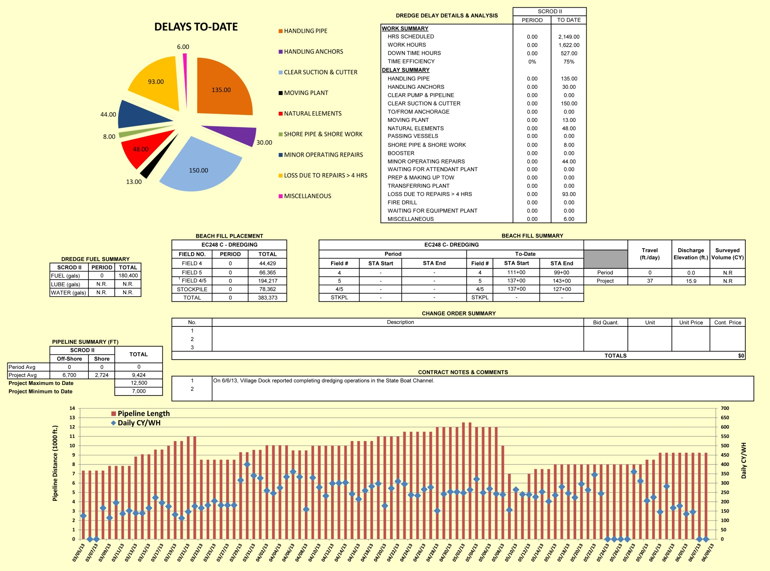
Excerpts from Weekly Reports

Slide 18
BOAT CHANNEL DREDGING 16 inch Hydraulic Dredge Scrod II

Slide 19
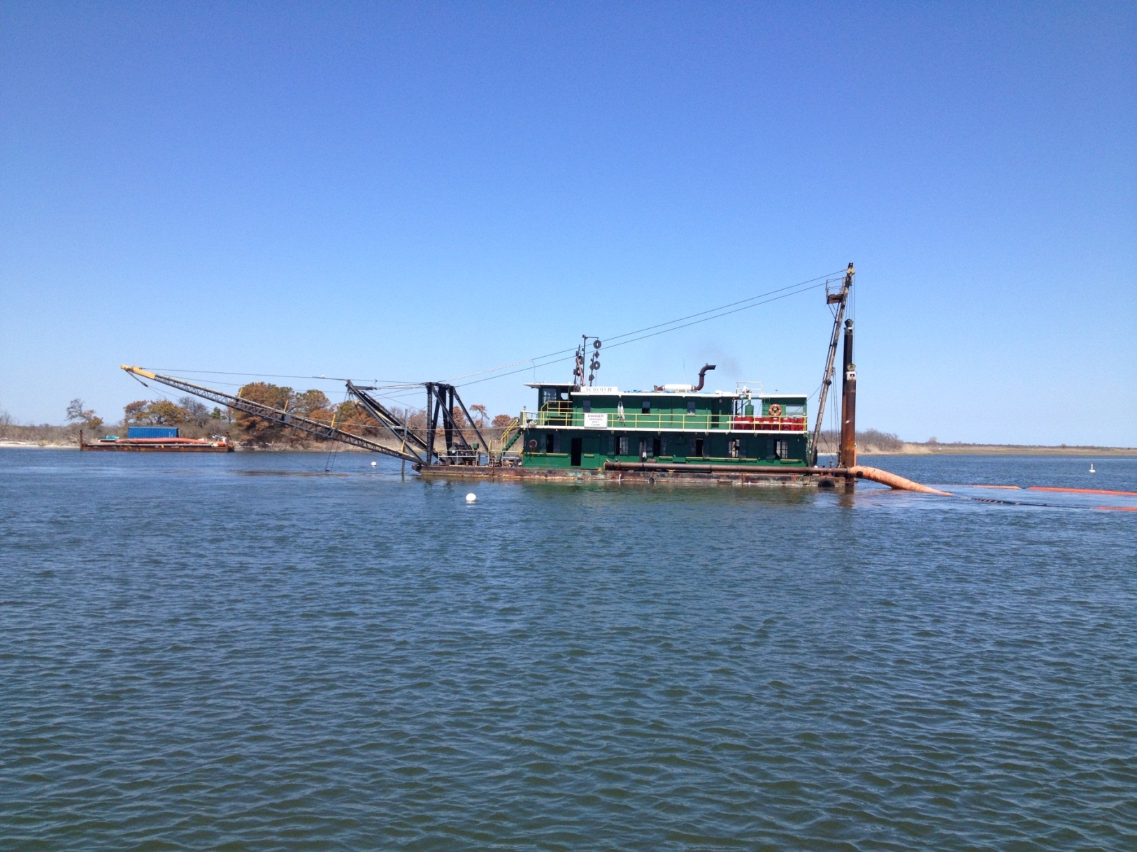
BOAT CHANNEL DREDGING

Slide 20
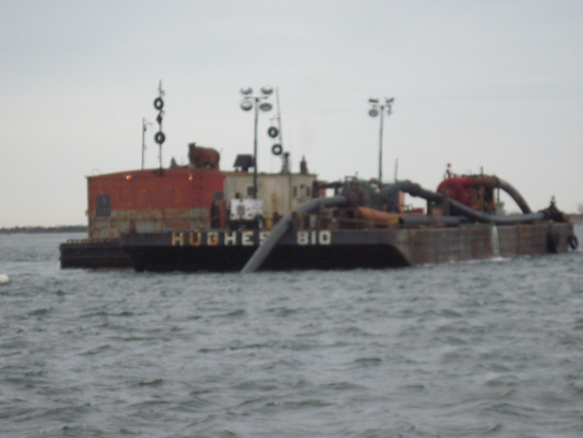
BOAT CHANNEL DREDGING

Slide 21
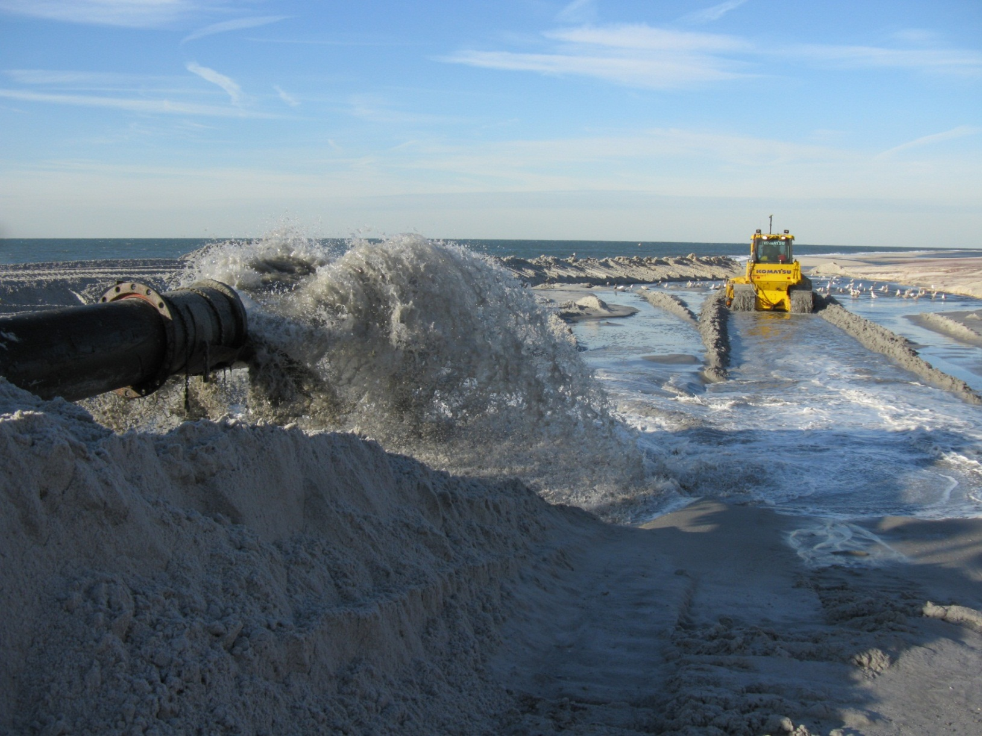
BOAT CHANNEL DREDGING

Slide 22
GRACE-TRUCKING FROM DEMOCRAT PT.
Planning and Design – Jan and Feb 2013
Solicitation Date March 12, 2013
Bid Date March 13, 2013
Notice to Proceed March 13, 2013
Start Truck Haul March 21, 2013
Finish Truck Haul April 12, 2013
Plover Habitat Grading - June 7 thru June 14

Slide 23
GRACE - TRUCKING FROM DEMOCRAT PT.
Ten Trucks, 30 – 40 ton. About 7,100 truck hauls
Haul from Democrat Pt. approximately 238,000 cy
Haul days approximately 18, 13,200 cy/day
Placement at Field 4 & 5
Engineering During Construction
Quantities and sand borrow locations modified
Permit modifications
Surveys, Measurement and Payment
Notes:
Verbally mention borrow areas permitted – existing elevation about +15?? Down to elevation +3 what datum. Borrow location added because funding and schedule allowed for it.

Slide 24
GRACE TRUCKING FROM DEMOCRAT PT.
Notes:
Verbally mention borrow areas permitted – existing elevation about +15?? Down to elevation +3 what datum. Borrow location added because funding and schedule allowed for it.

Slide 25
GRACE TRUCKING FROM DEMOCRAT PT.

Slide 26
GRACE TRUCKING TO ROBERT MOSES

Slide 27
GRACE TRUCKING TO ROBERT MOSES

Slide 28
GRACE PLOVER GRADING
Plover Grading Area

Slide 29
GRACE - PLOVER GRADING

Slide 30
GRACE PIPING PLOVER GRADING
Looking NW

Slide 31
NYS DOT - Norfolk Dredging & Stockpile
24” Hydraulic Dredge Charleston – 10,000 HP
Dredged F.I. Inlet – Stockpile 200,000 cy ++
Tri-Venture Trucking from Democrat Pt.
Haul days approximately 30
Placement at Field 5
Coordination – State Agencies, Engineers and Contractors.

Slide 32
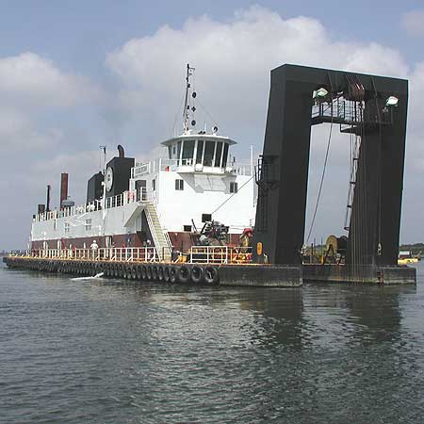
NYS DOT - Norfolk Dredging & Stockpile 24 in. Hyd Dredge “Charleston”

Slide 33
NYS DOT - Norfolk Dredging & Stockpile

Slide 34
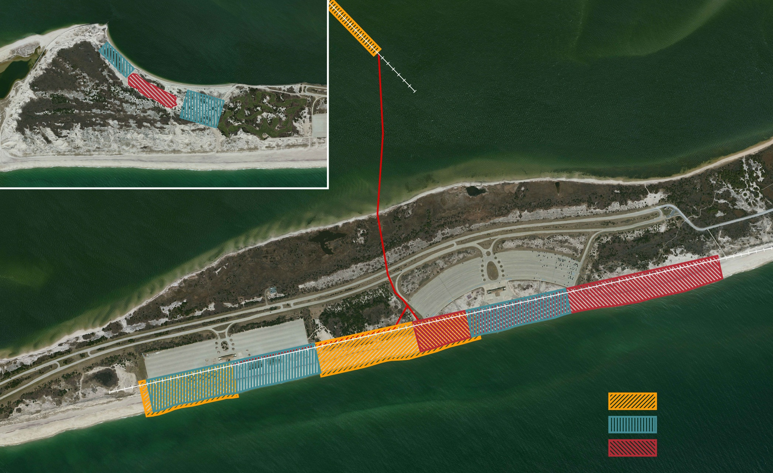
Emergency Beach Fill – Summary
Grace Borrow Area
Norfolk Dredging Stockpile
Field #5
Field #4
7800 ft. of Beach - Restored
Legend
385,000 CY
Village Dock
238,000 CY
Grace Industries
150,000 CY
Tri-Venture

Slide 35
Robert Moses Emergency Beach Fill Summary with Cost / Cy
Contractor | Borrow Source | Quantity Cy. | Cost $/CY
Village Dock | Boat Channel | 385,000 | $18
Grace Industries | Democrat Pt. | 238,000 | $8
Tri - Venture | Democrat Pt. | 150,000 | Not Available
TOTAL |  | 773,000
Notes:
Third option for Harbor material will give us capacity for 20 years.
Source of slide: Frank Hamons’ presentation to DMMP Executive Committee, 10/26/11.

Slide 36
Robert Moses Emergency Beach Fill Summary
 | March | April | May | June | July
Dredging Start
March 5th
Mem. Day Holiday Shutdown
Dredging Complete June 6th
Village Dock
385 k-cy – 4,260 cy/day
Trucking Start
March 21st
Trucking Finish
April 12th
Grading Beach and Plover Habitat
Complete June 14th
Grace Industries
238 k-cy – 13,600 cy/day
Trucking Start
April 13th
Trucking Complete
May 12th
NYS DOT - Tri-Venture
150 k-cy – 13,600 cy/day
Notes:
Third option for Harbor material will give us capacity for 20 years.
Source of slide: Frank Hamons’ presentation to DMMP Executive Committee, 10/26/11.

Slide 37
Questions ????

Slide 38
End
38

Slide 39
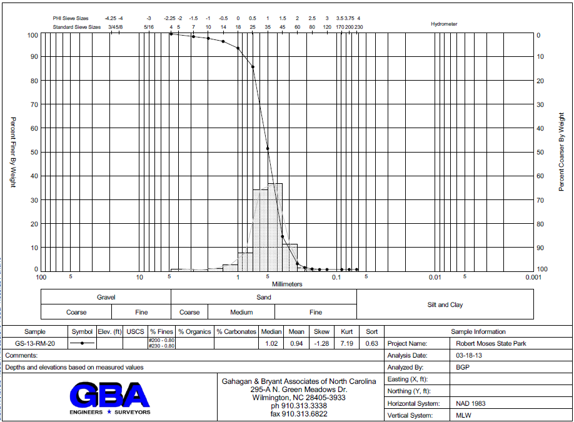
39
Notes:
Native beach sand – Grain Size Distribution

Slide 40
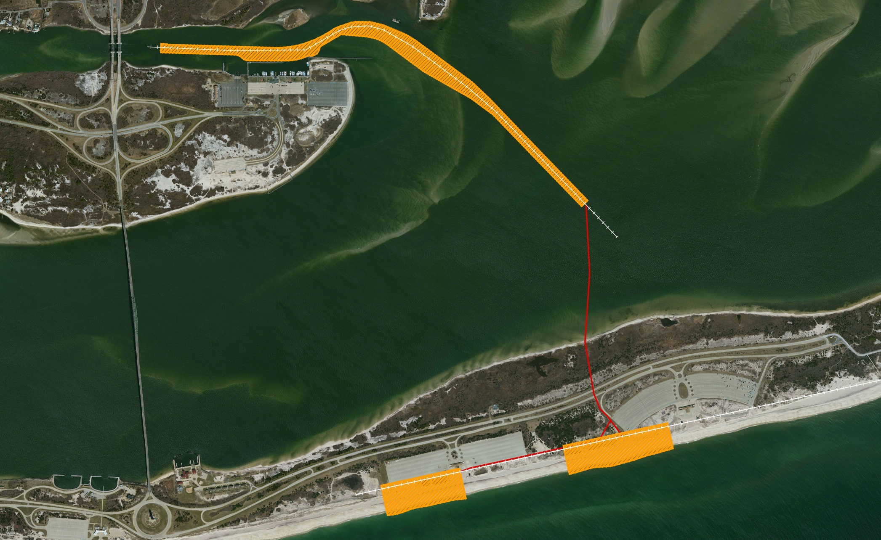
State Boat Channel Emergency Dredging
State Boat Channel Emergency Dredging
Contractor: Village Dock With Hydraulic Dredge
40
Dredge Pipeline
Field Area #5
Field Area #4
Emergency Beach Fill

Slide 41
PROJECT LOCATIONS
Fire Island Inlet
Grace Trucking Borrow Area
Democrat Point
Norfolk Dredging Stockpile –
Tri-Venture Trucking

Slide 42
PROJECT LOCATIONS
Grace Trucking Borrow Area
Norfolk Dredging Stockpile
Field Area #5
Field Area #4

